Slide 1
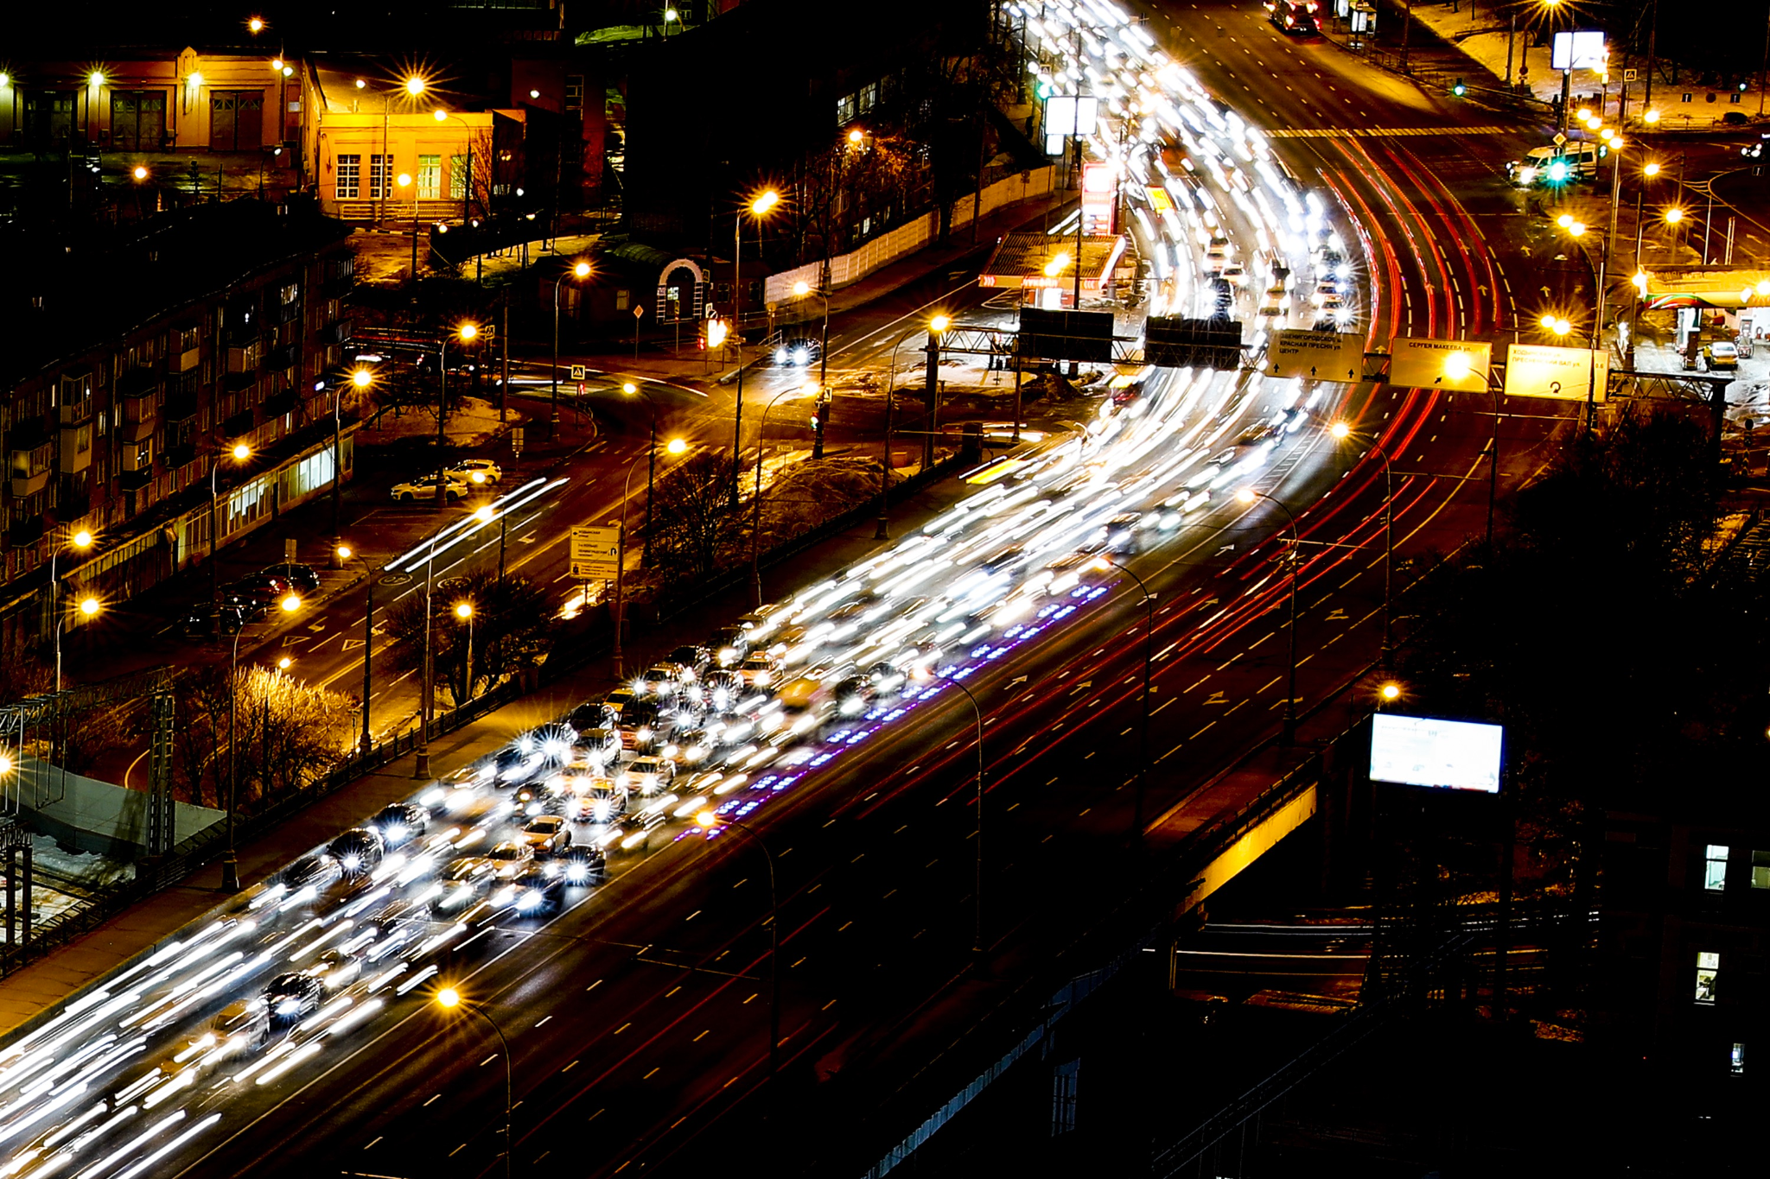
US ACCIDENTS ANALYSIS
-Urvish Patel

Slide 2

Dataset
This is a countrywide traffic accident dataset, which covers 49 states of the United States.
The data was collected from February 2016, using several data providers, including multiple APIs that provide streaming traffic event data.

Slide 3
Data Attributes
​​ID
Severity
Start_Time
End_Time
Start_Lat
Start_Lng
End_Lat
End_Lng
Distance(mi)
Description
Number
Street
Side
City
County
State
Zipcode
Country
Timezone
Airport_Code
Weather_Timestamp
Temperature(F)
Wind_Chill(F)
Humidity(%)
Pressure(in)
Visibility(mi)
Wind_Direction
Wind_Speed(mph)
Precipitation(in)
Weather_Condition
Amenity
Bump
Crossing
Give_Way
Junction
No_Exit
Railway
Roundabout
Station
Stop
Traffic_Calming
Traffic_Signal
Turning_Loop
Sunrise_Sunset
Civil_Twilight
Nautical_Twilight
Astronomical_Twilight
Notes:
The dataset has 47 columns as you can see on the screen, Among which ….. Are categorical and … are numerical.

Slide 4
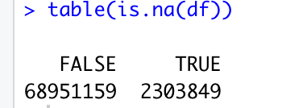
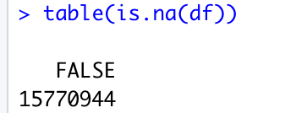
Data Cleaning
Eliminate null values
2. Eliminate redundant columns
Notes:
Identified number of null values
Removed the null values
There are 47 columns in total. After applying unique function, all the redundant column are removed and we are left with 34 variables.

Slide 5
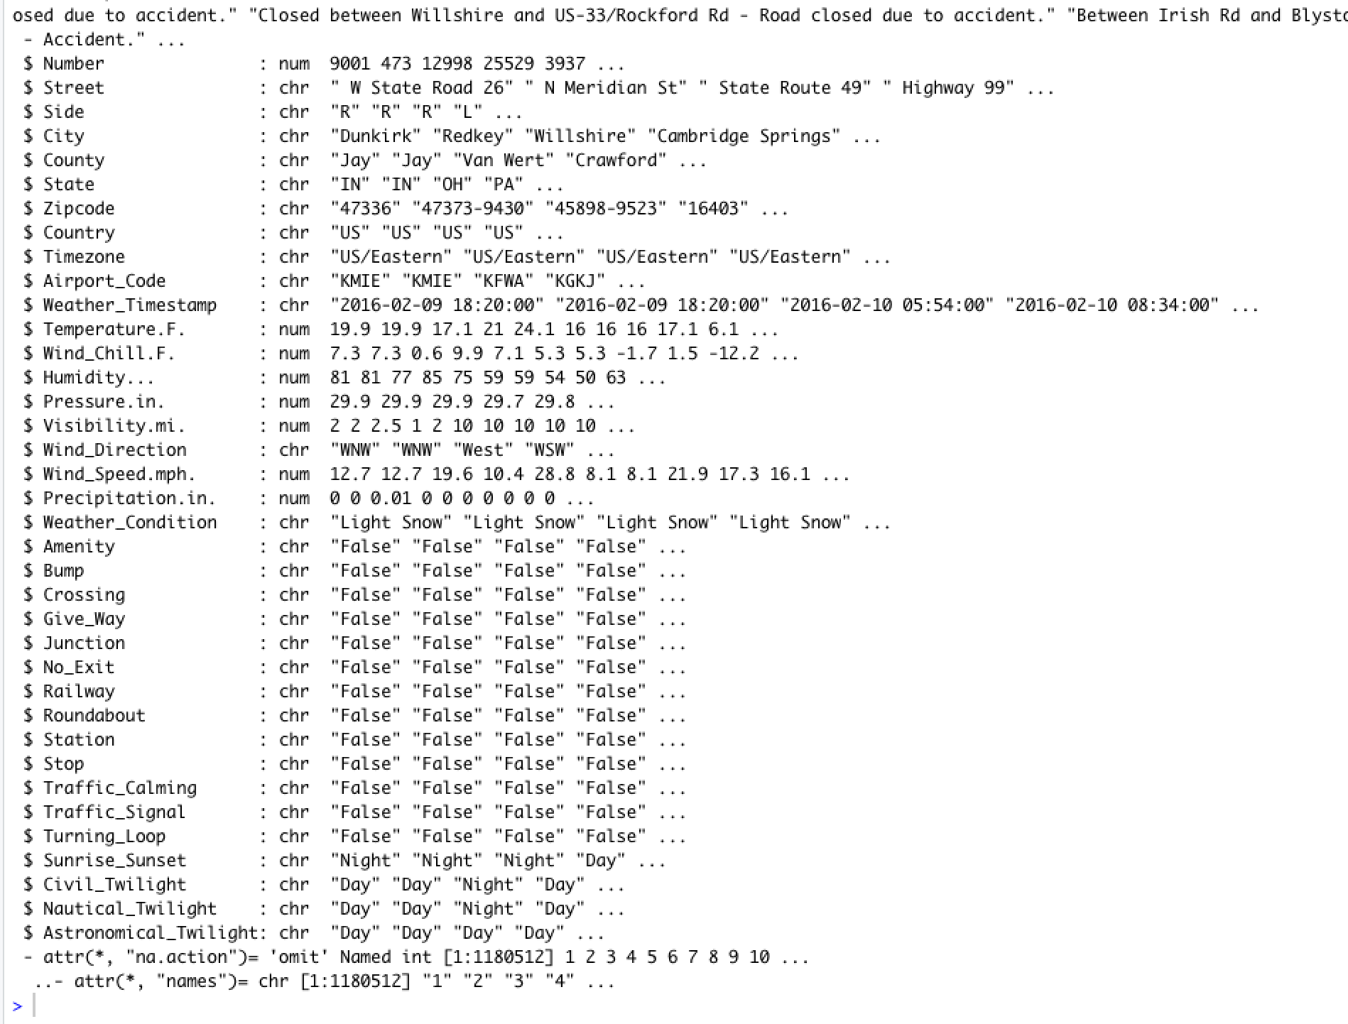
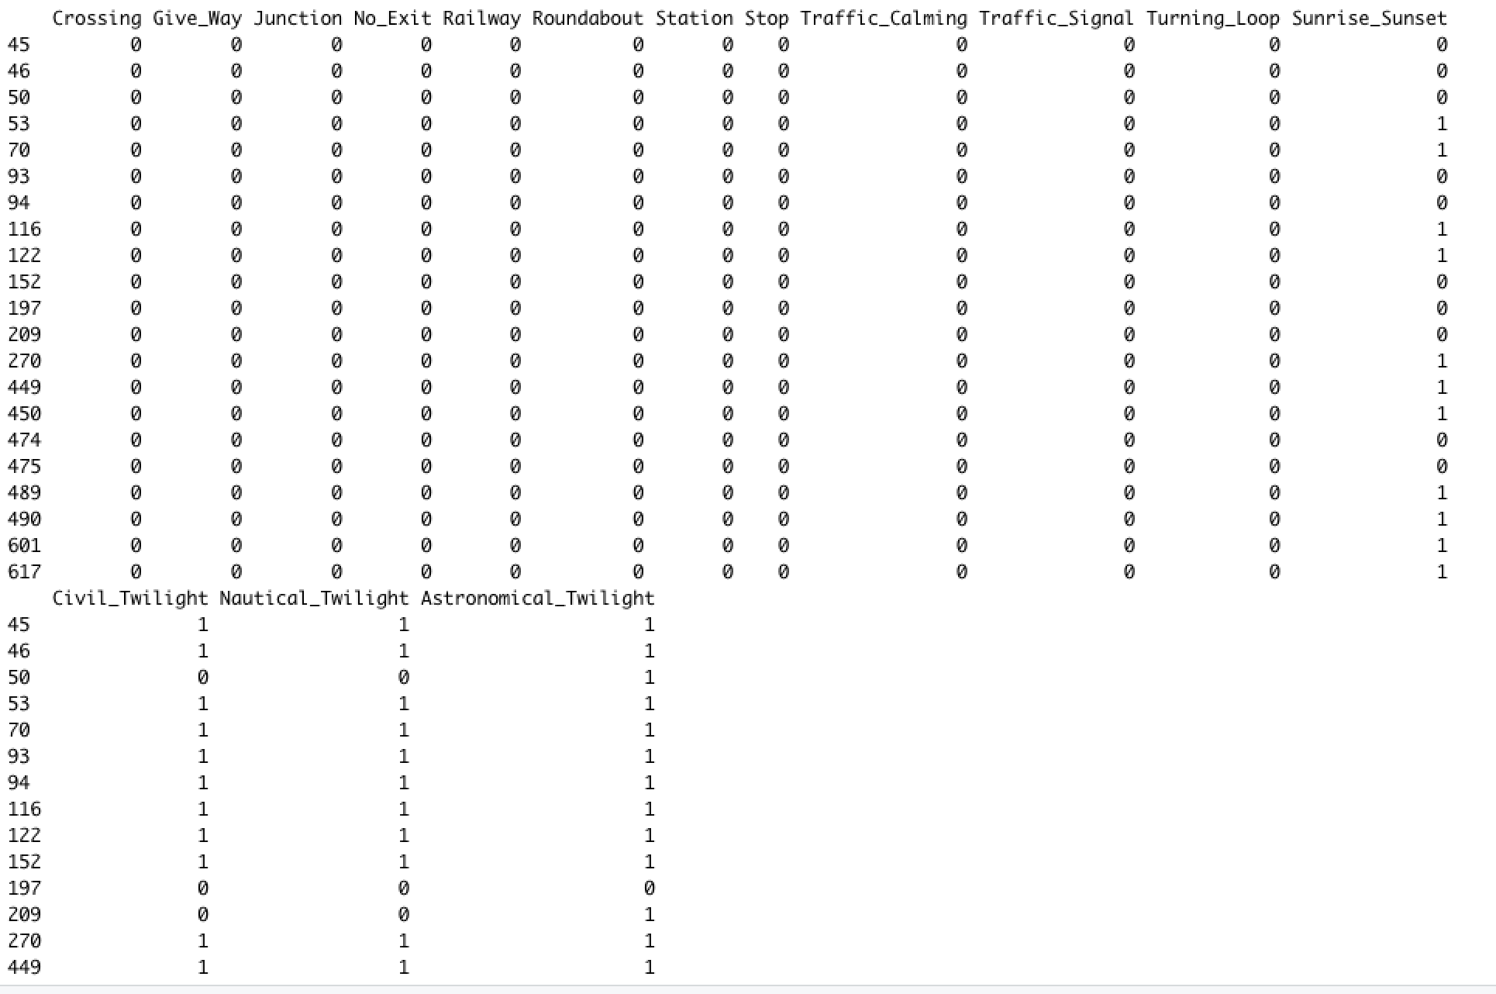
Data Transformation
Notes:
We have transformed the columns with character data type into numerical in order to make the data feasible for regression.

Slide 6
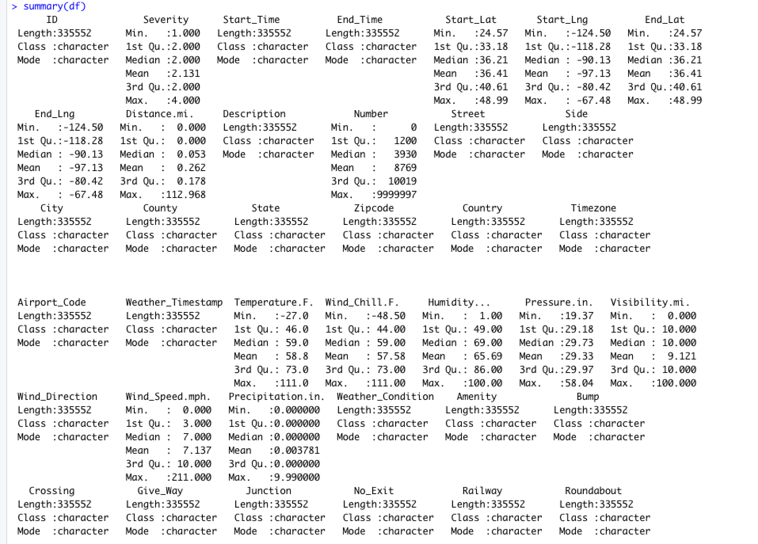
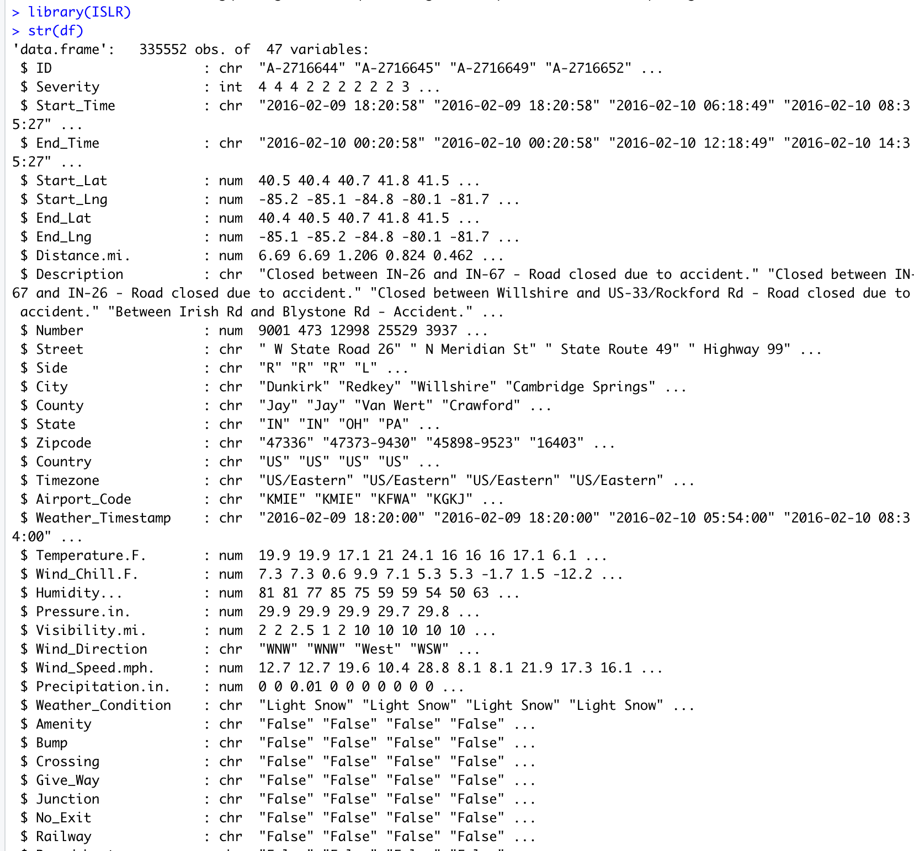
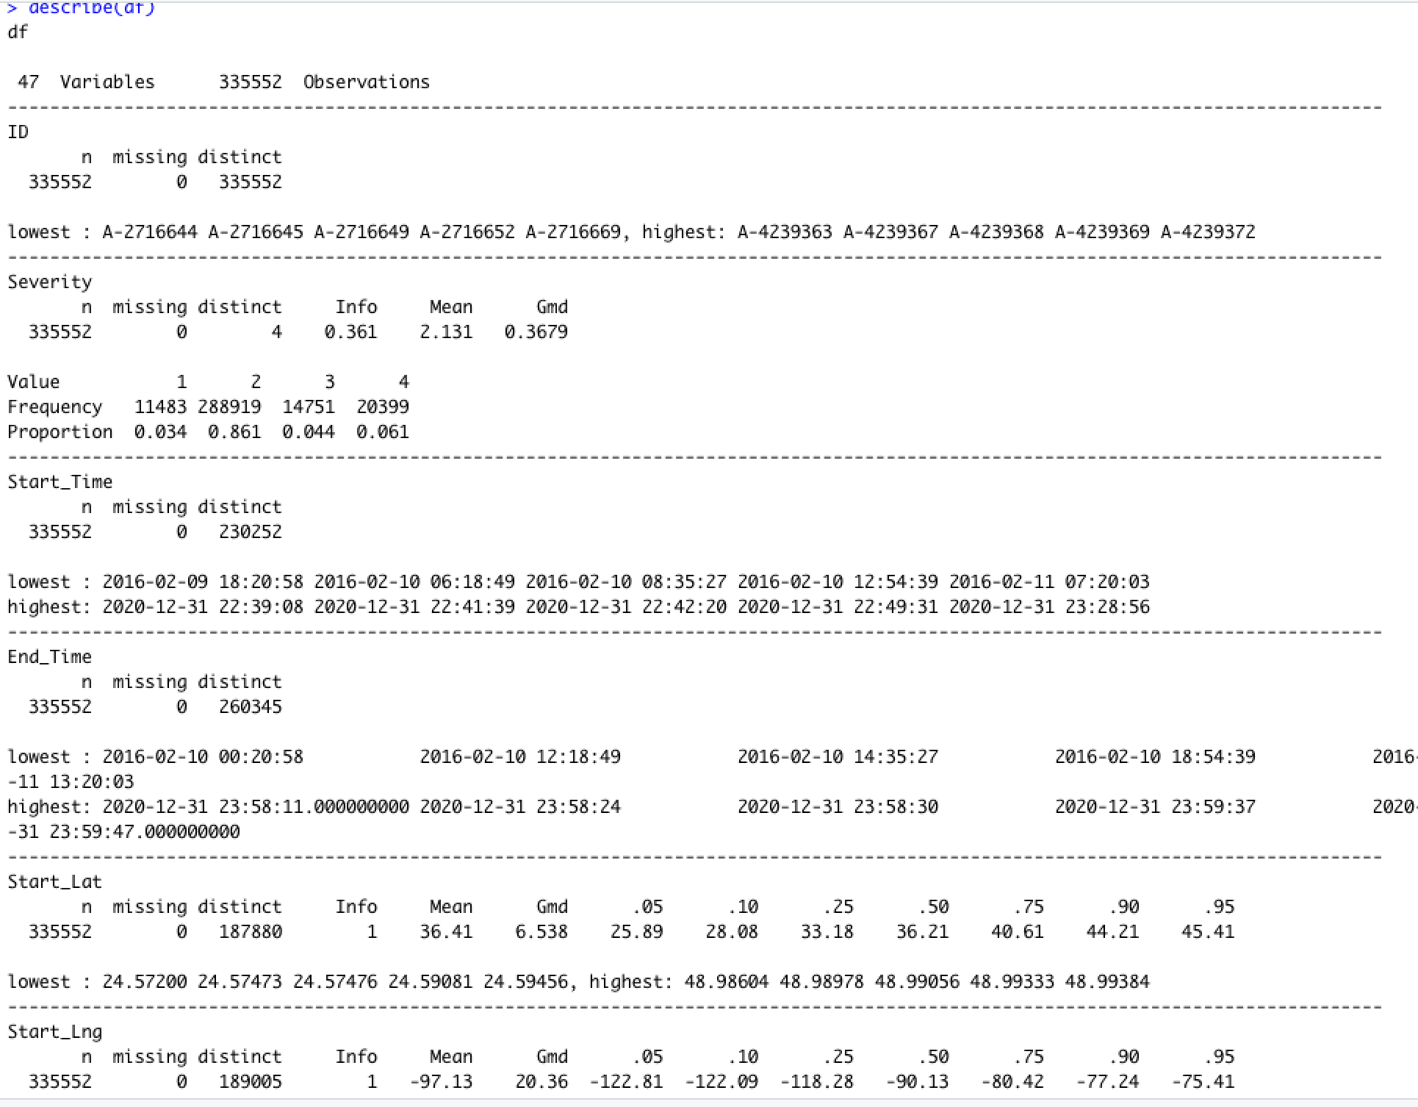
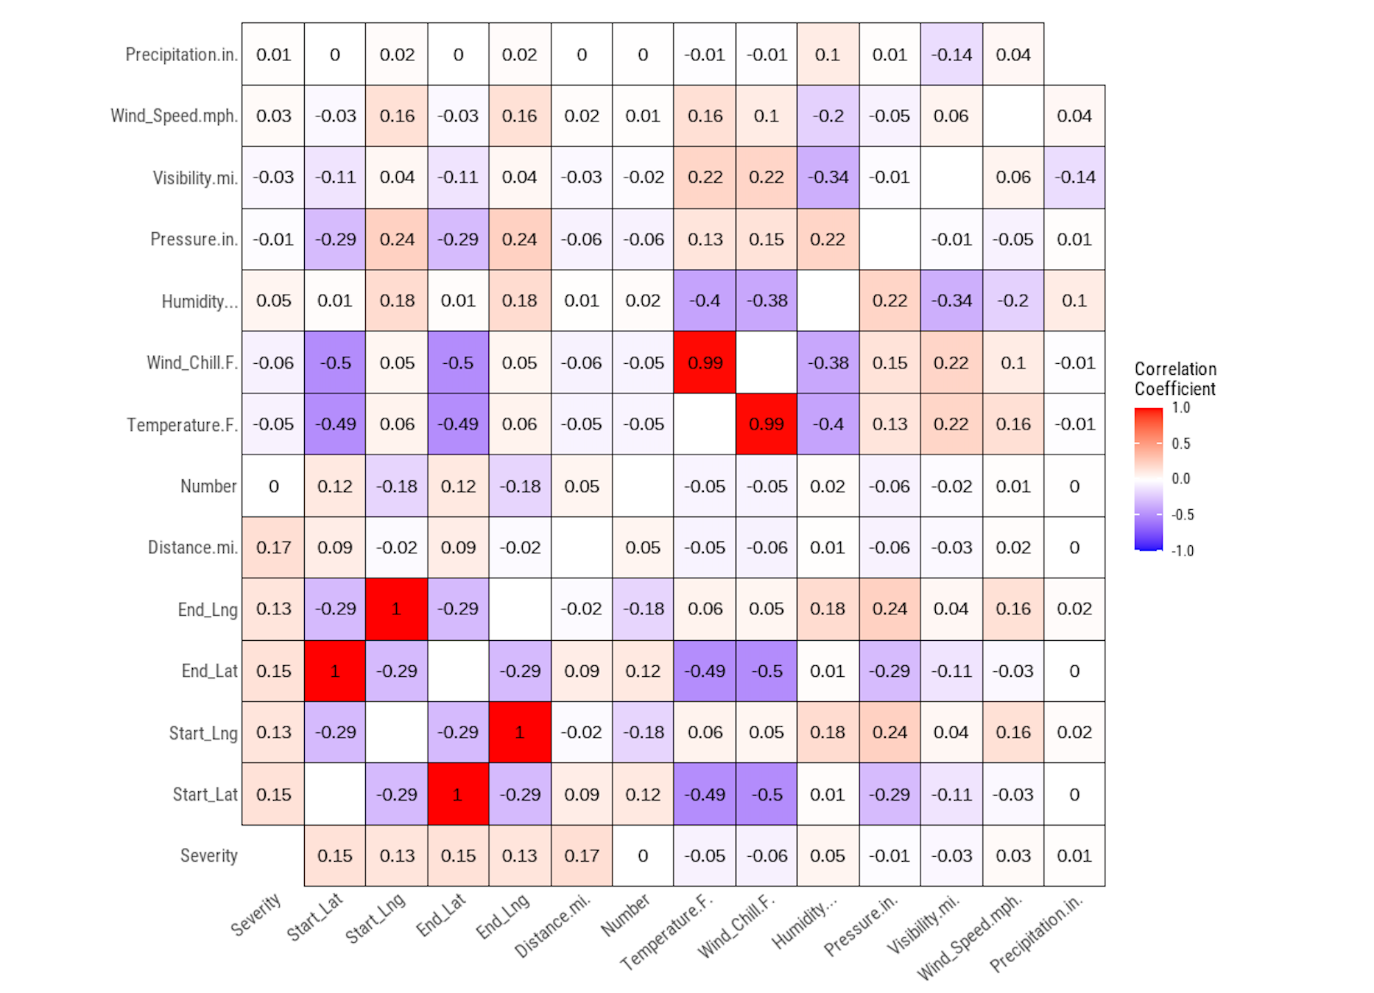
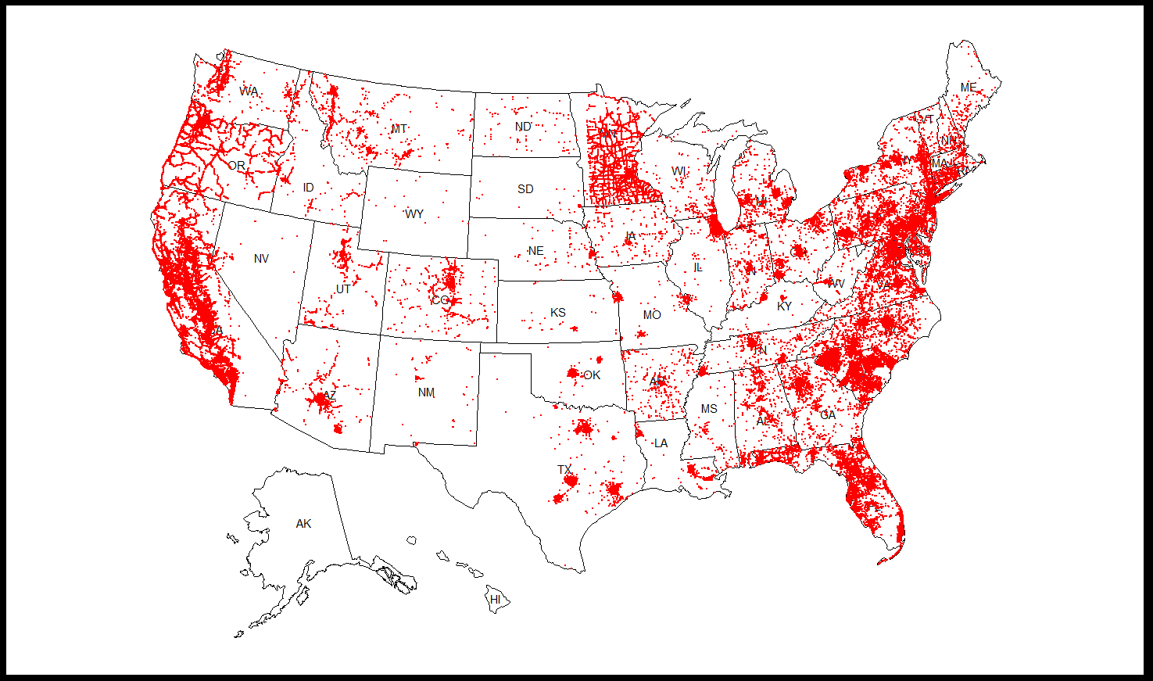
EDA
Notes:
1.Derive data from summary
Derive data from describe (also what is “lowest “in each variable?)
Box plots
Histograms
Correlation matrix

Slide 7
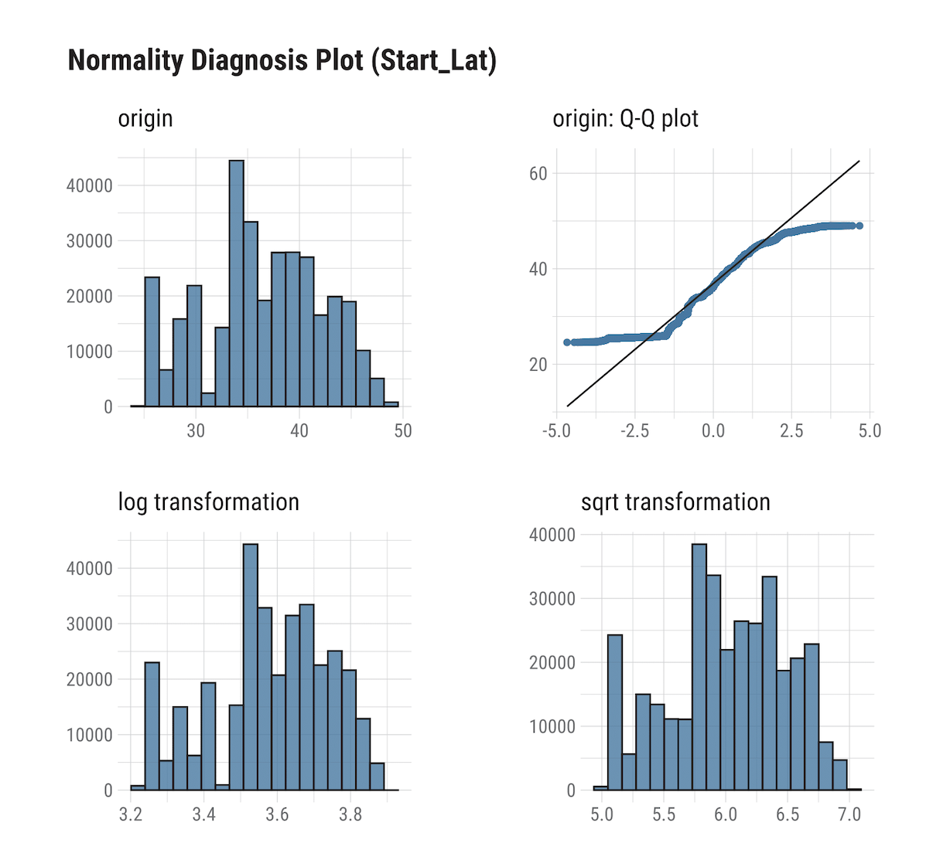
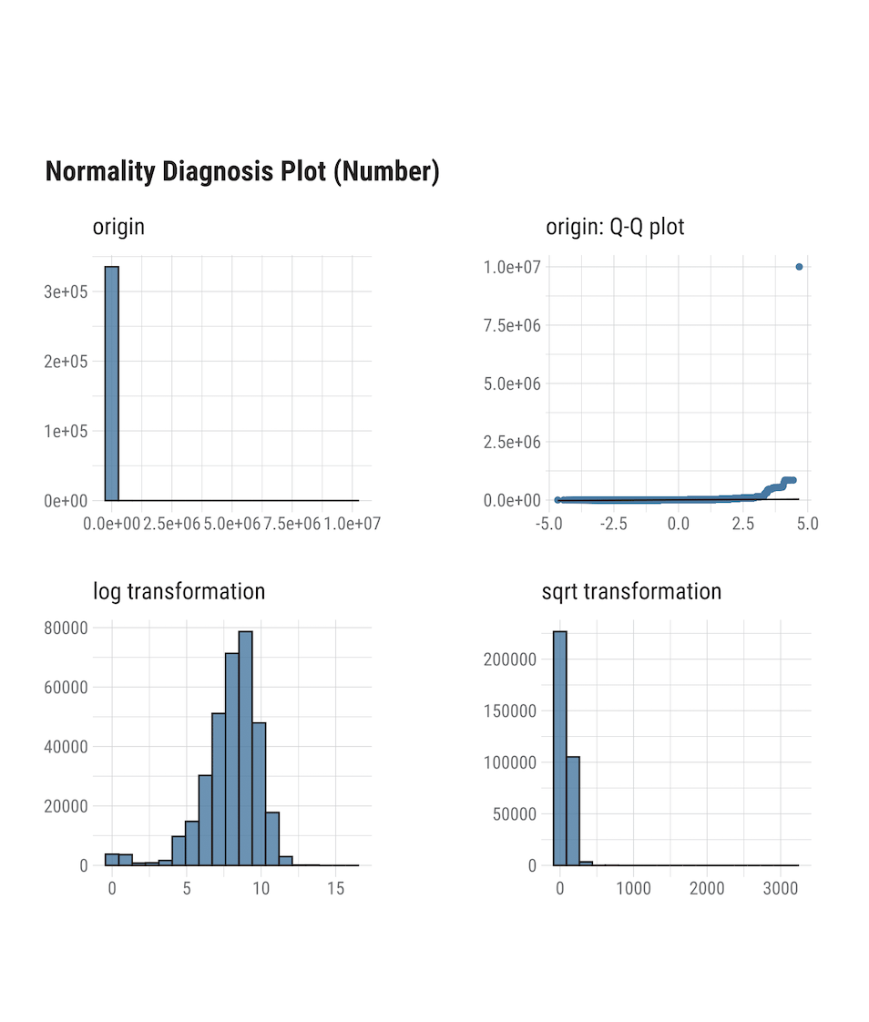
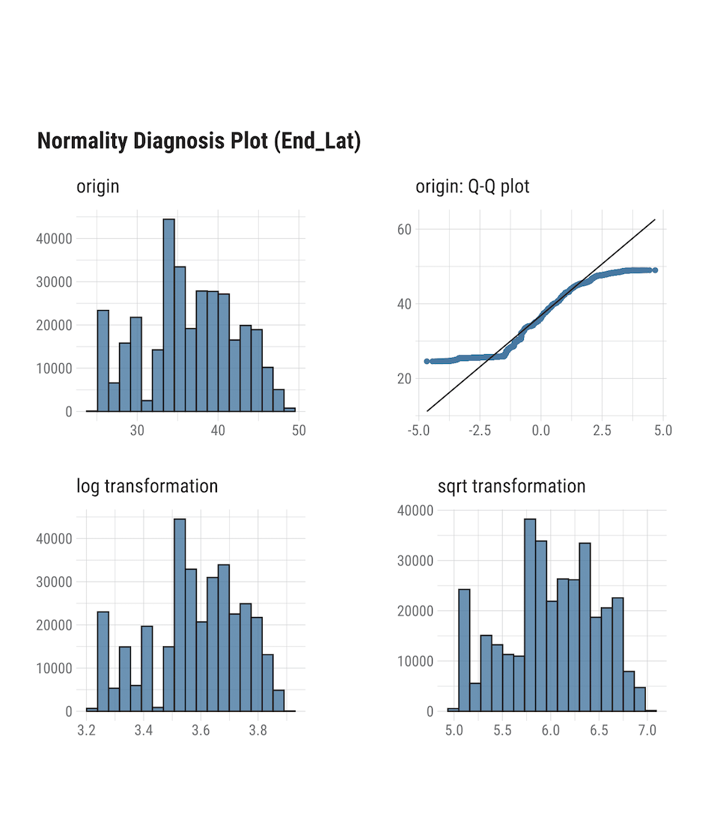
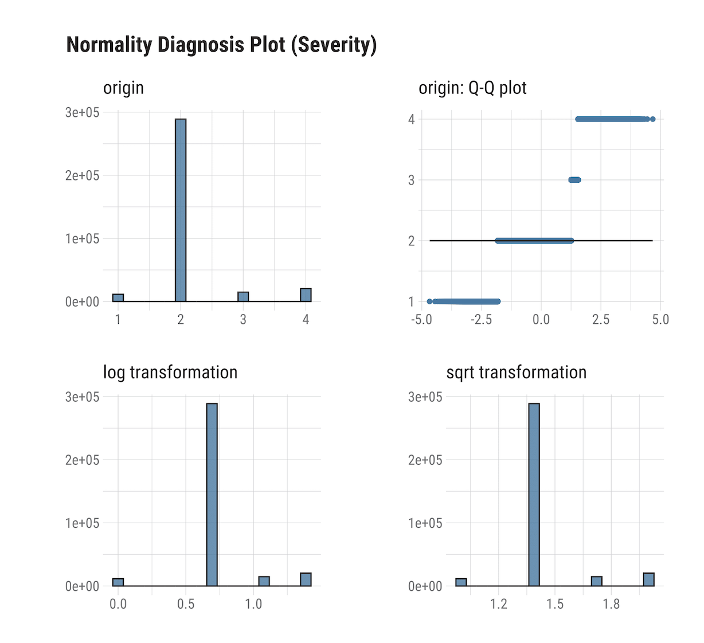
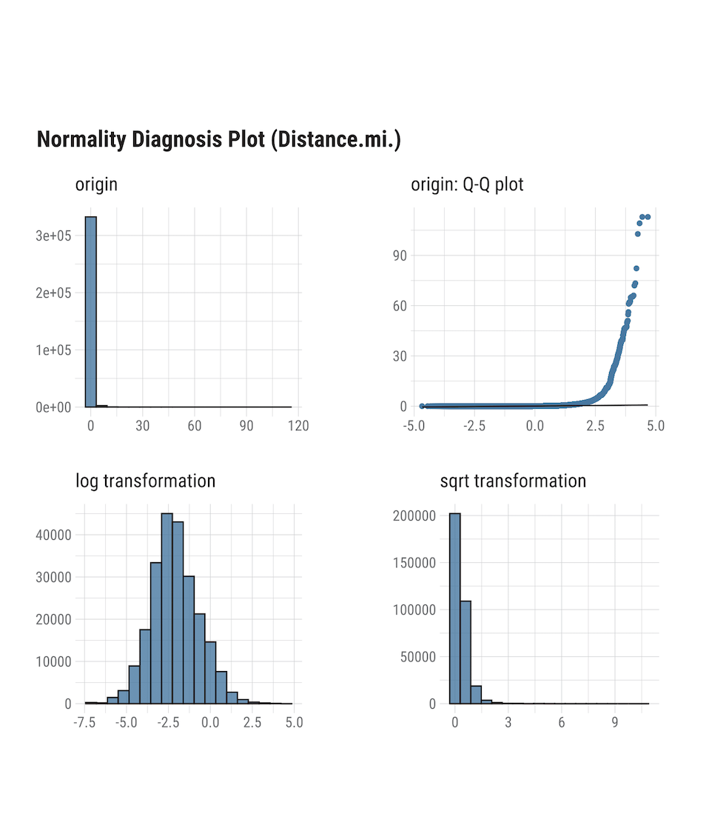
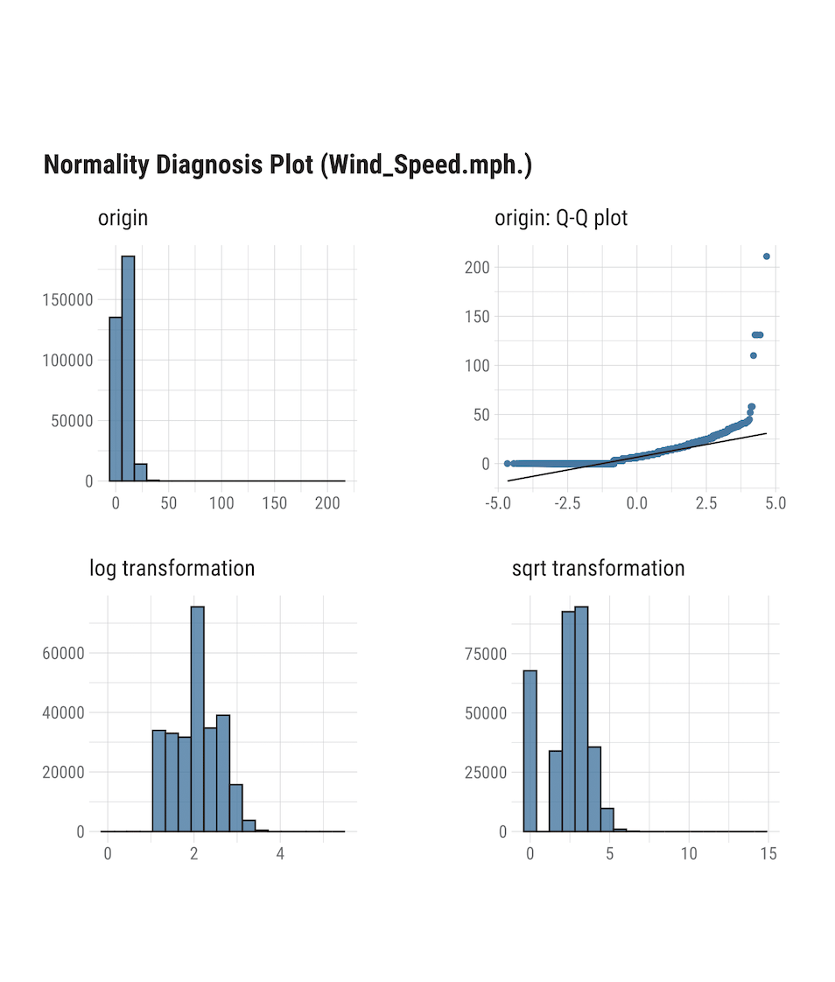
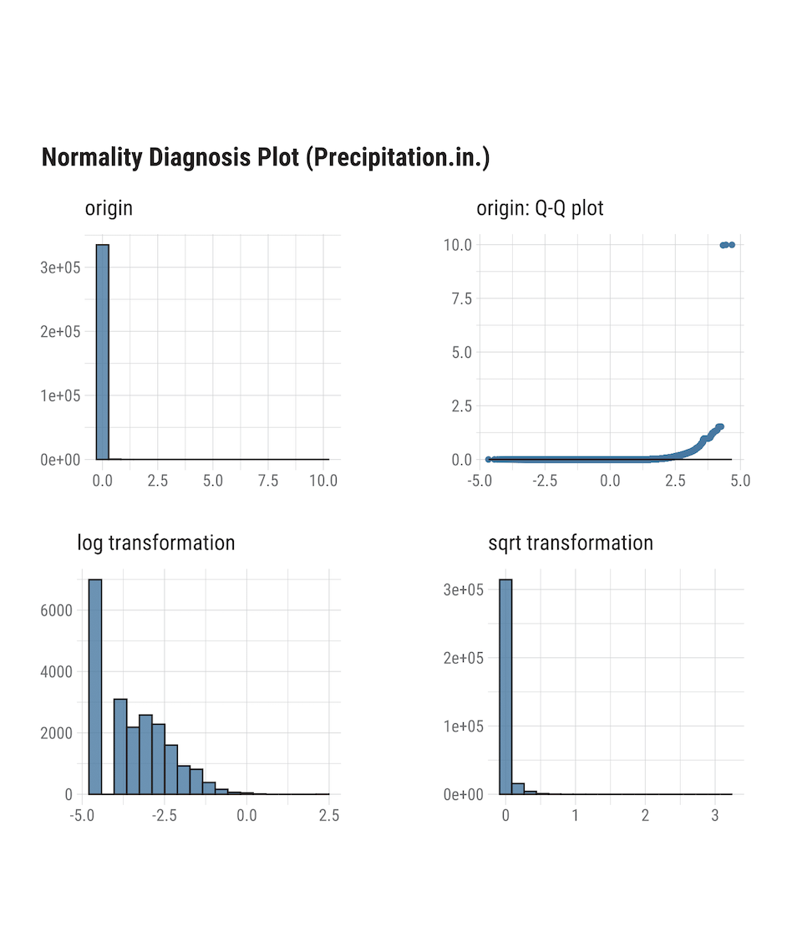
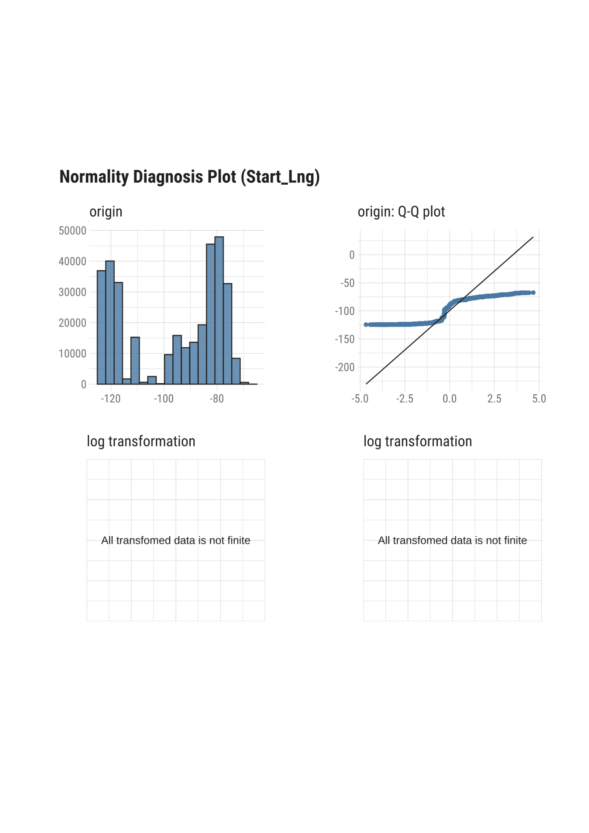
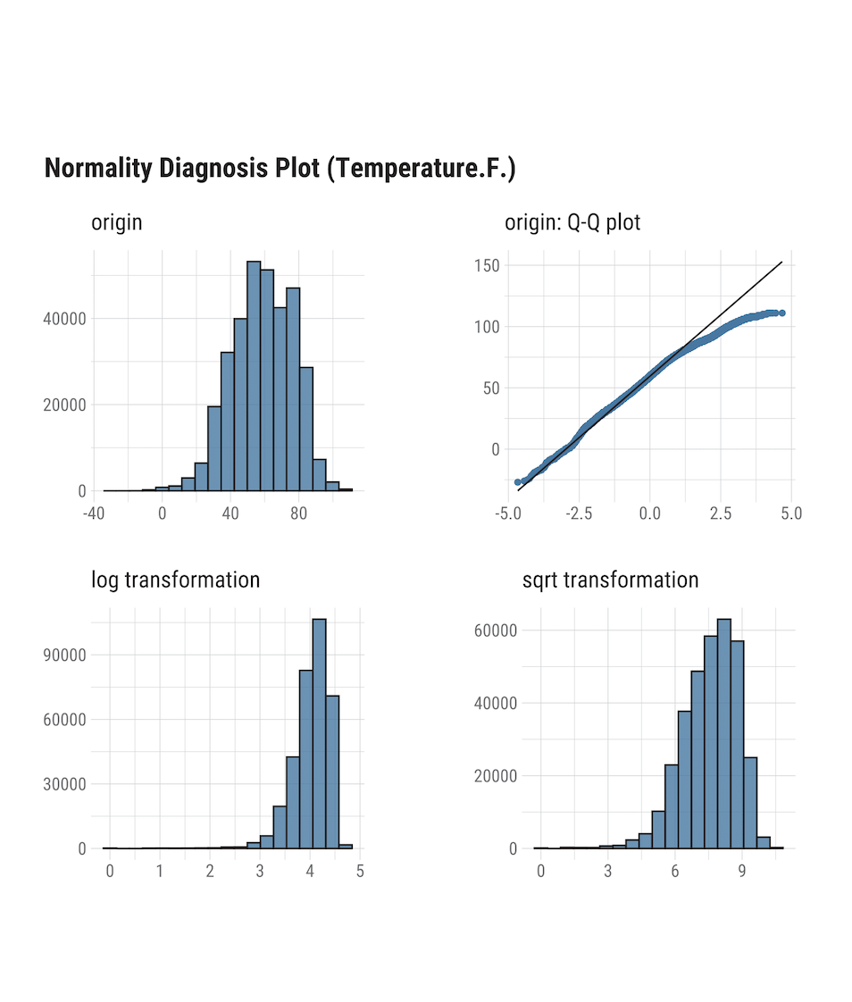
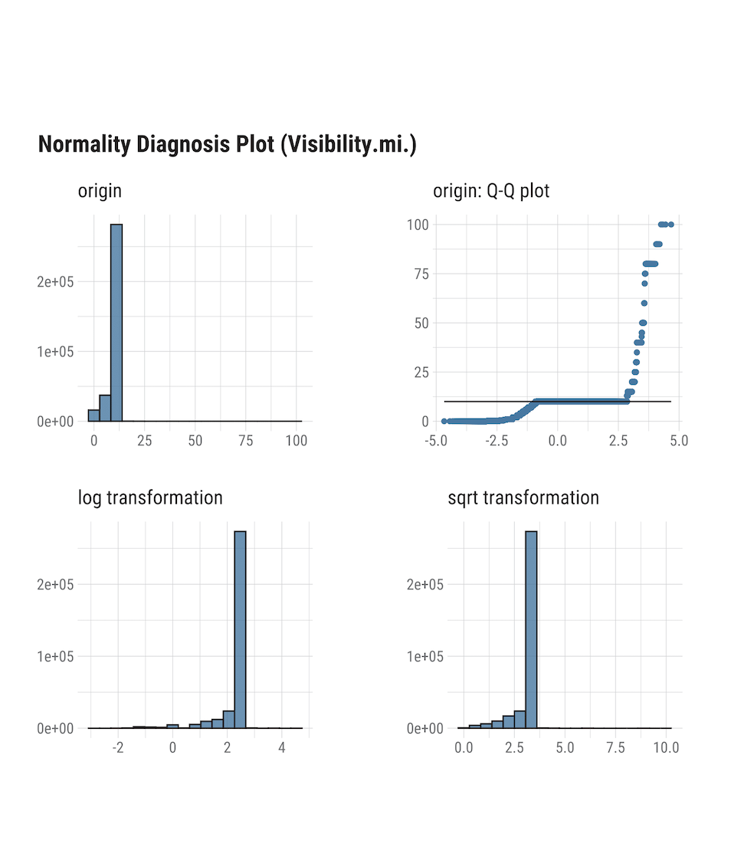
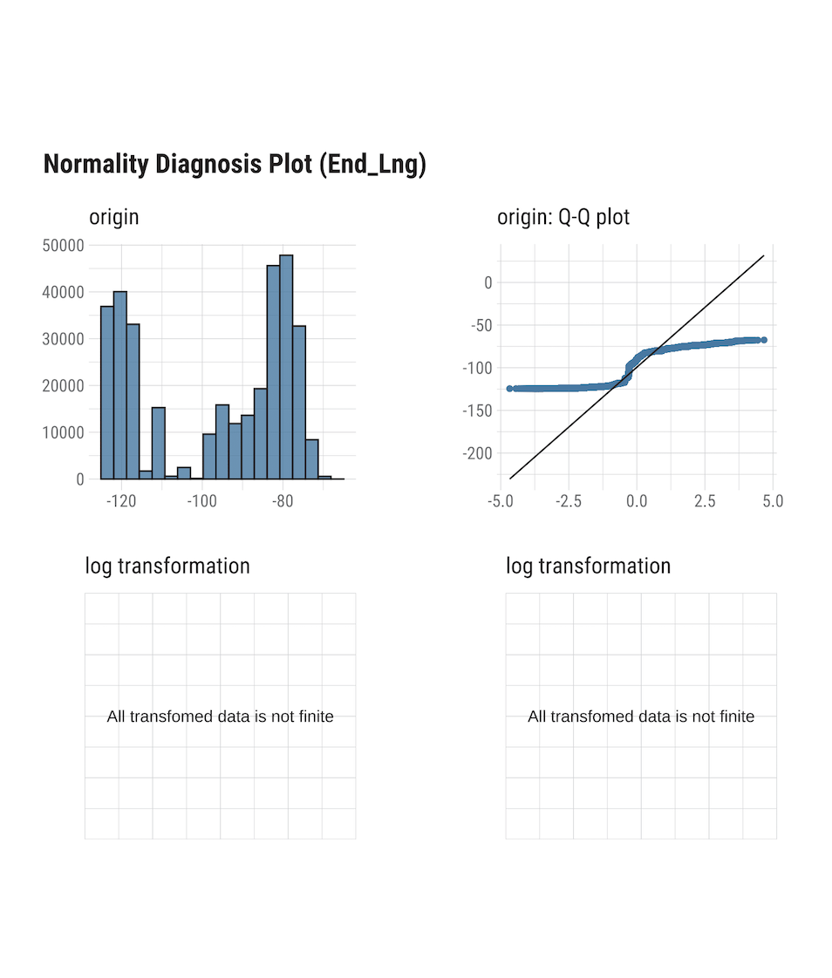
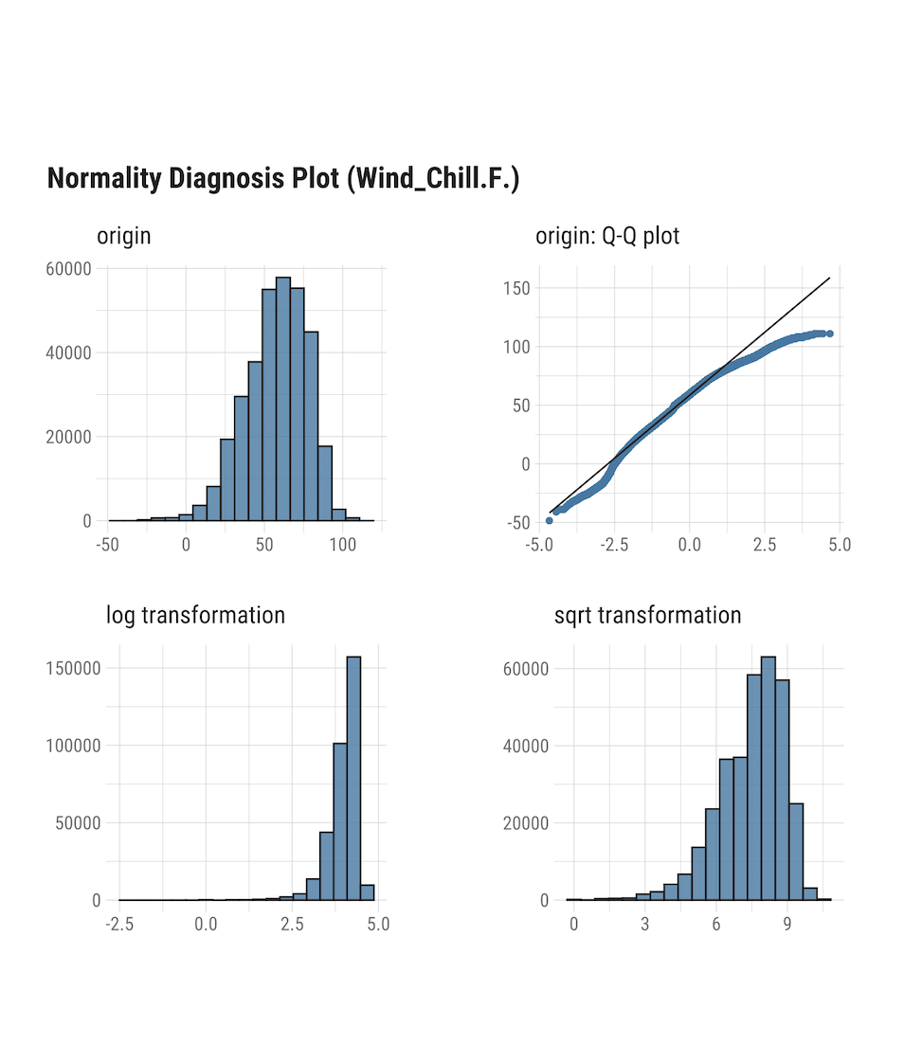
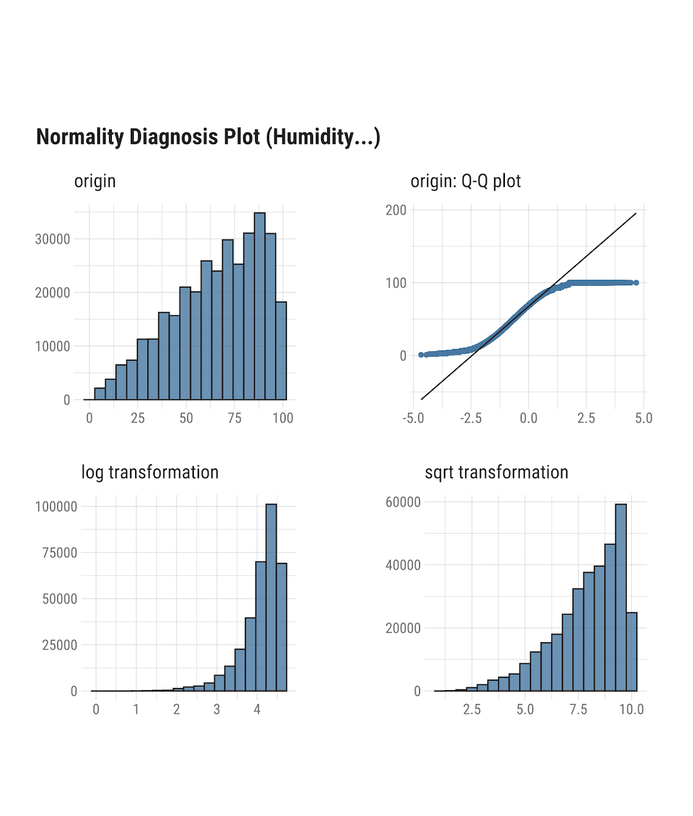
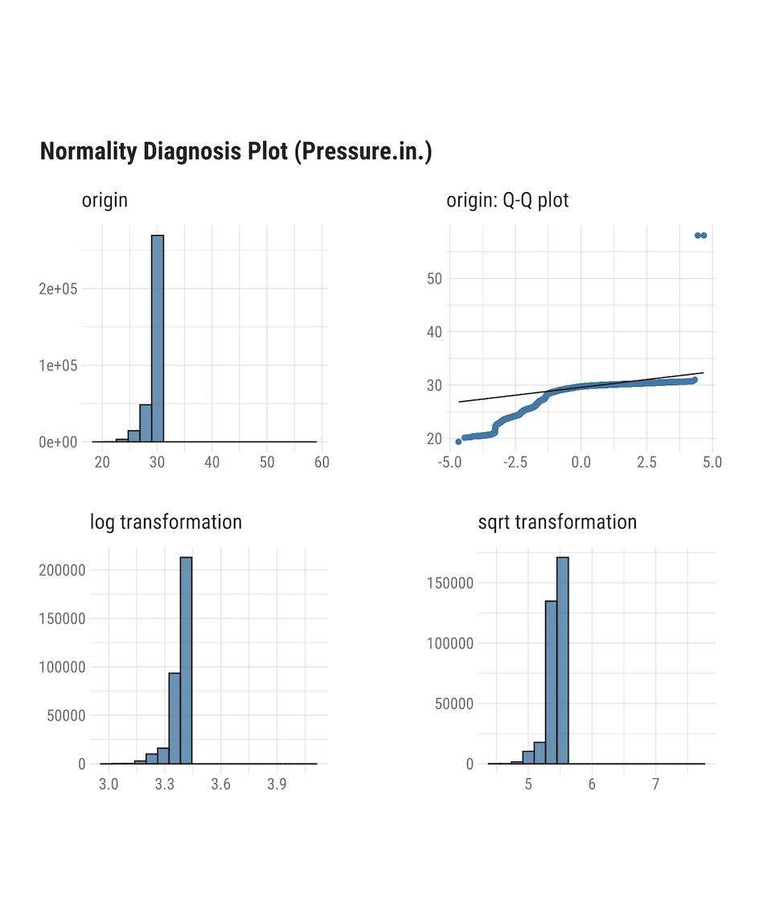

Slide 8
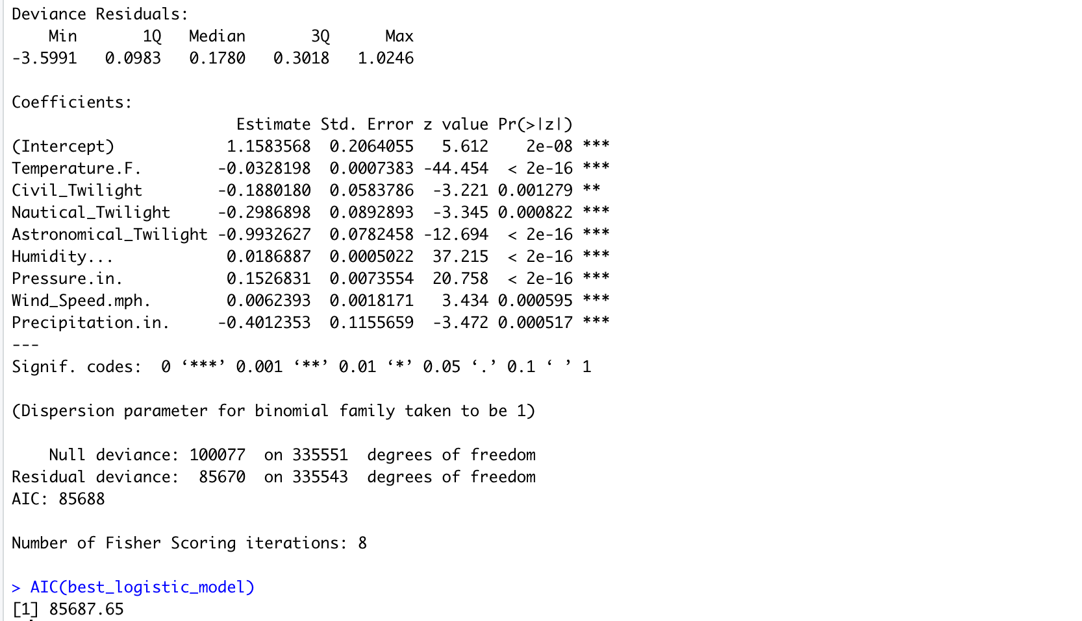
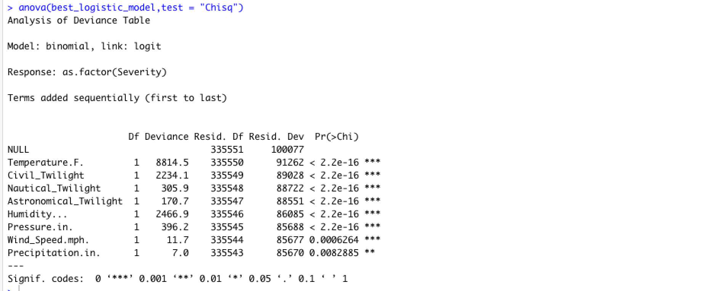
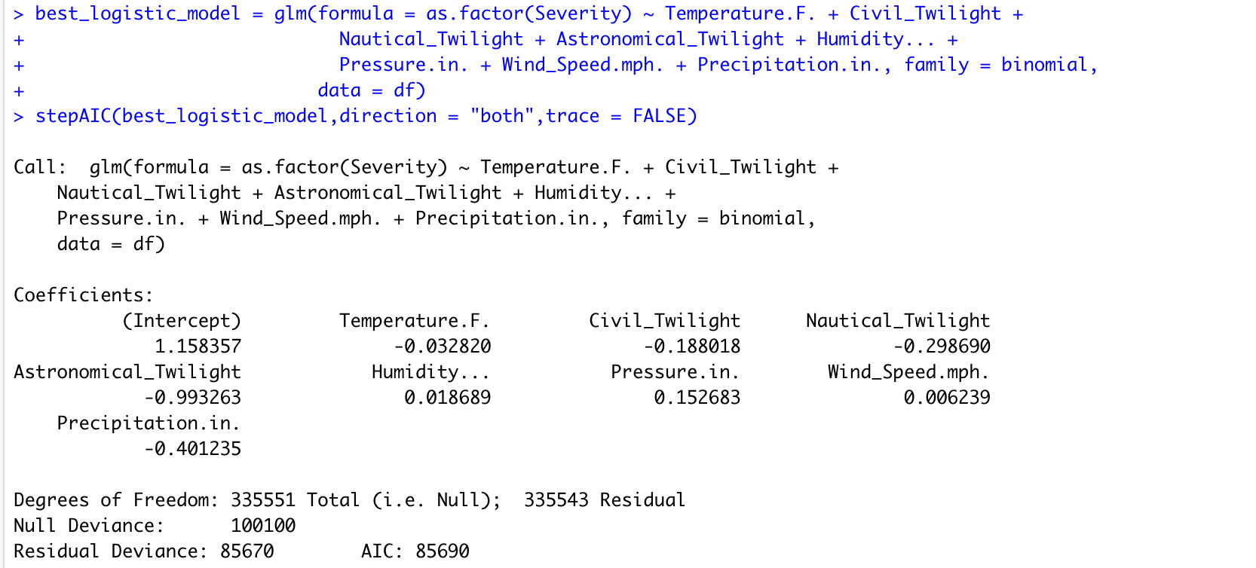
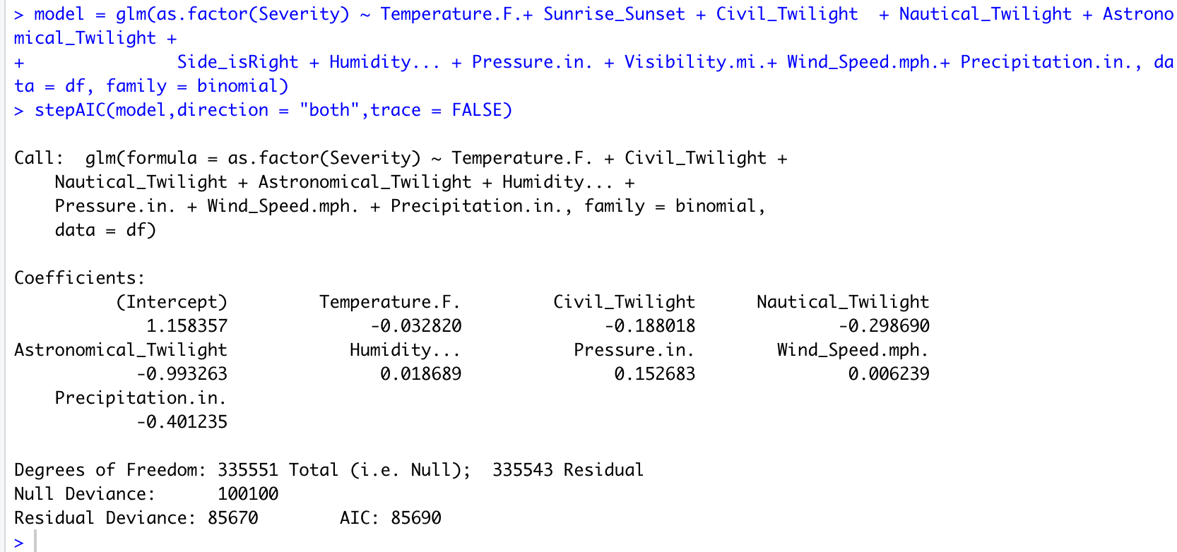
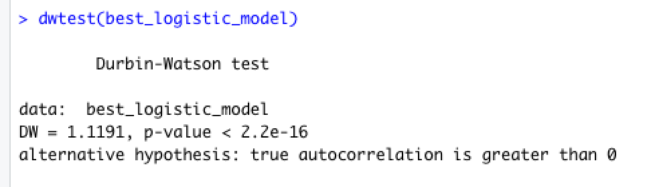
Logistic regression Model
Notes:
What is logistic regression and how did we apply for our data
Observations of model
What is step AIC
Observations of best model
DW test and correlation

Slide 9
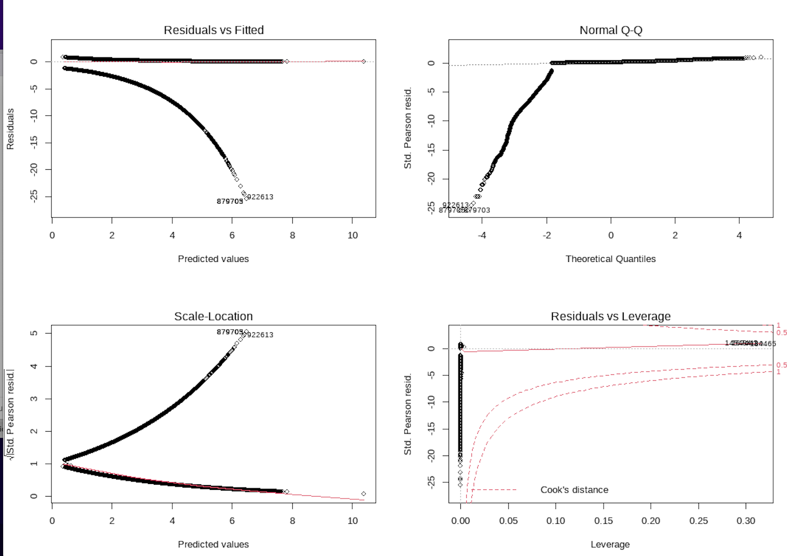
Assumptions

Slide 10
Variance Inflation factor

Slide 11
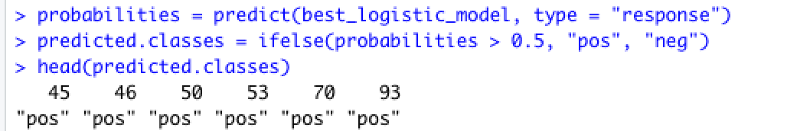
Model Prediction
Best model is taken to train and test
Summary of 80% data is taken and 20% predicted
If the Probability of predicted values compared to actual greater than 0.5 then it is considered to be positive outcome. If the probability is less than 0.5 it is considered to be negative outcome.
Mean value=r2

Slide 12
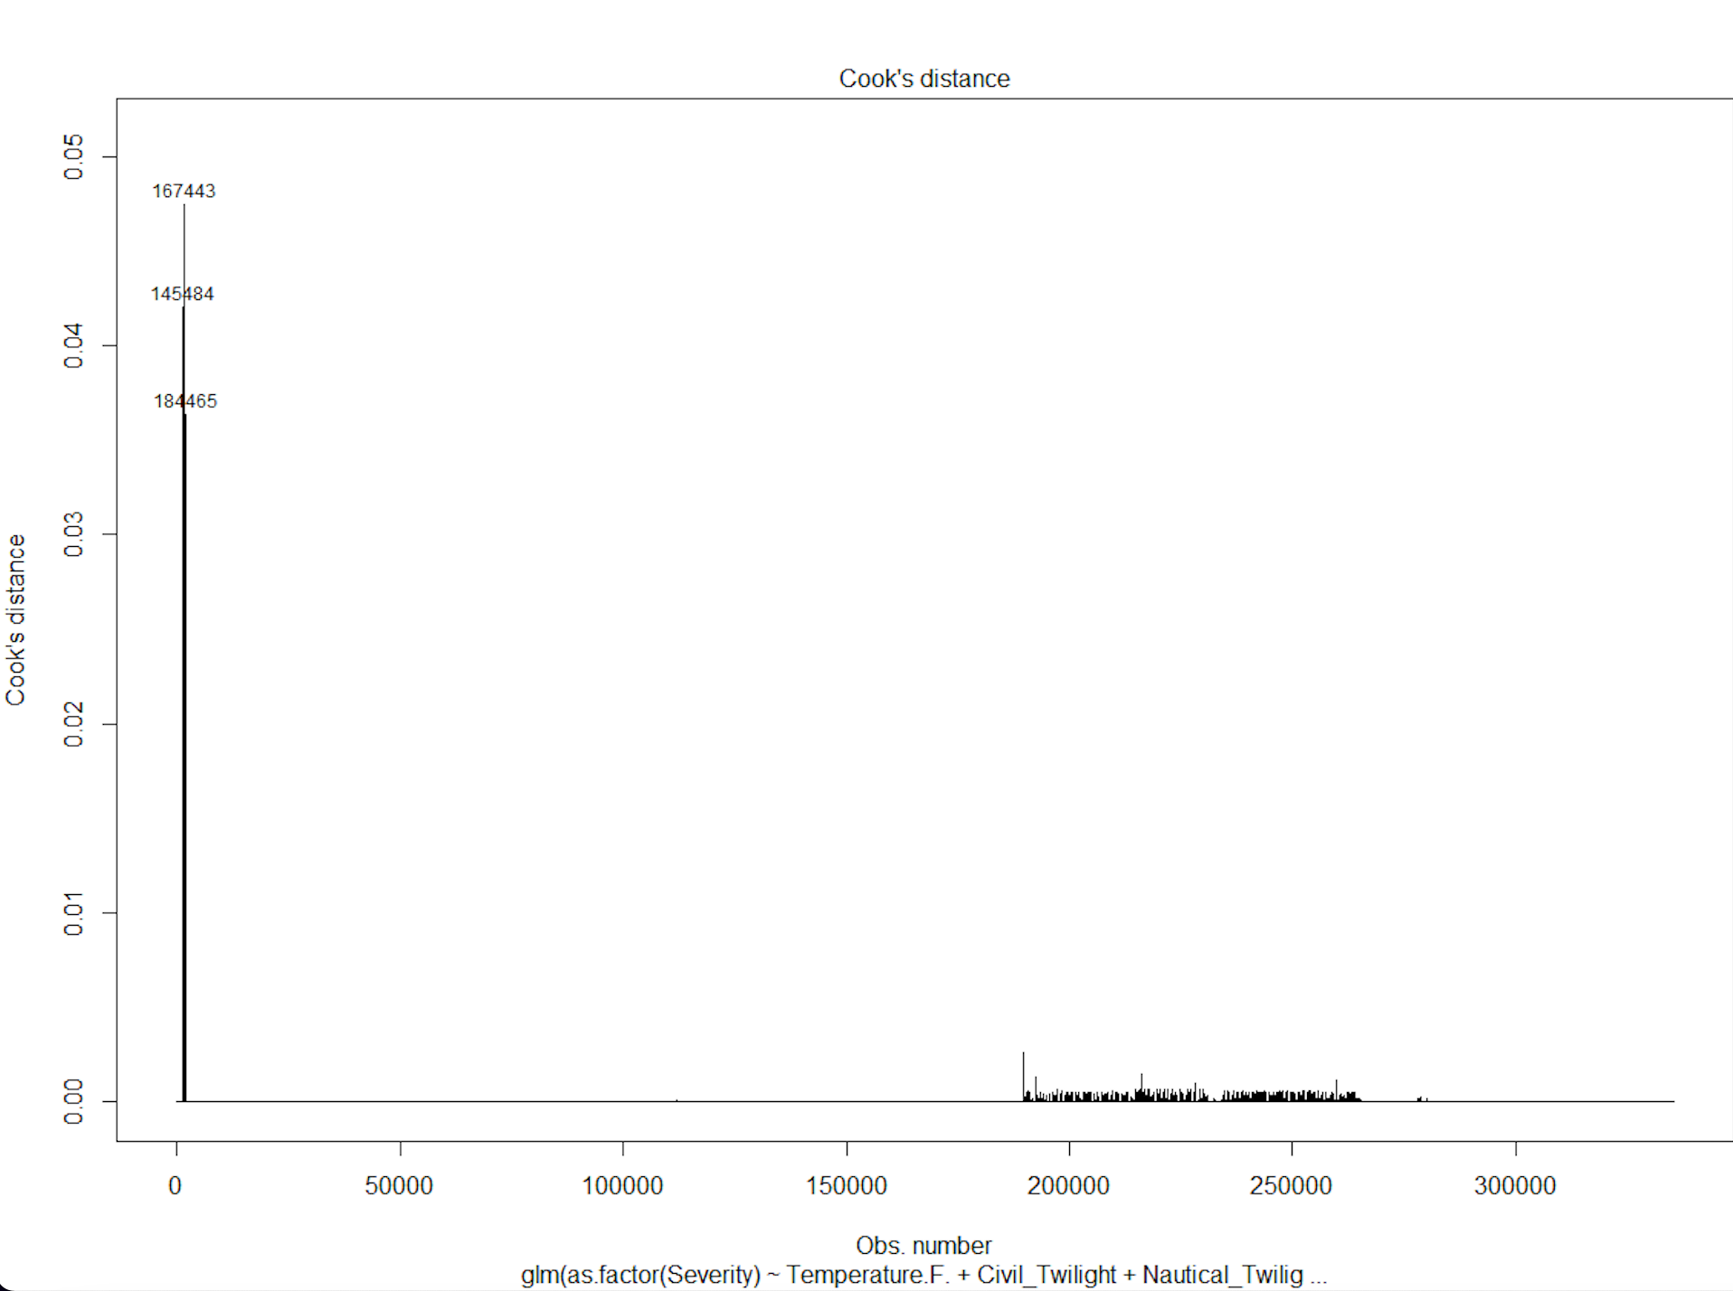
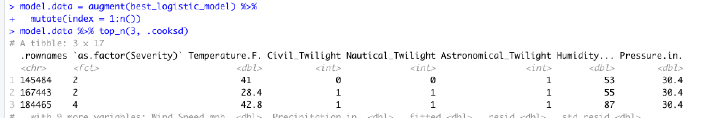

Slide 13
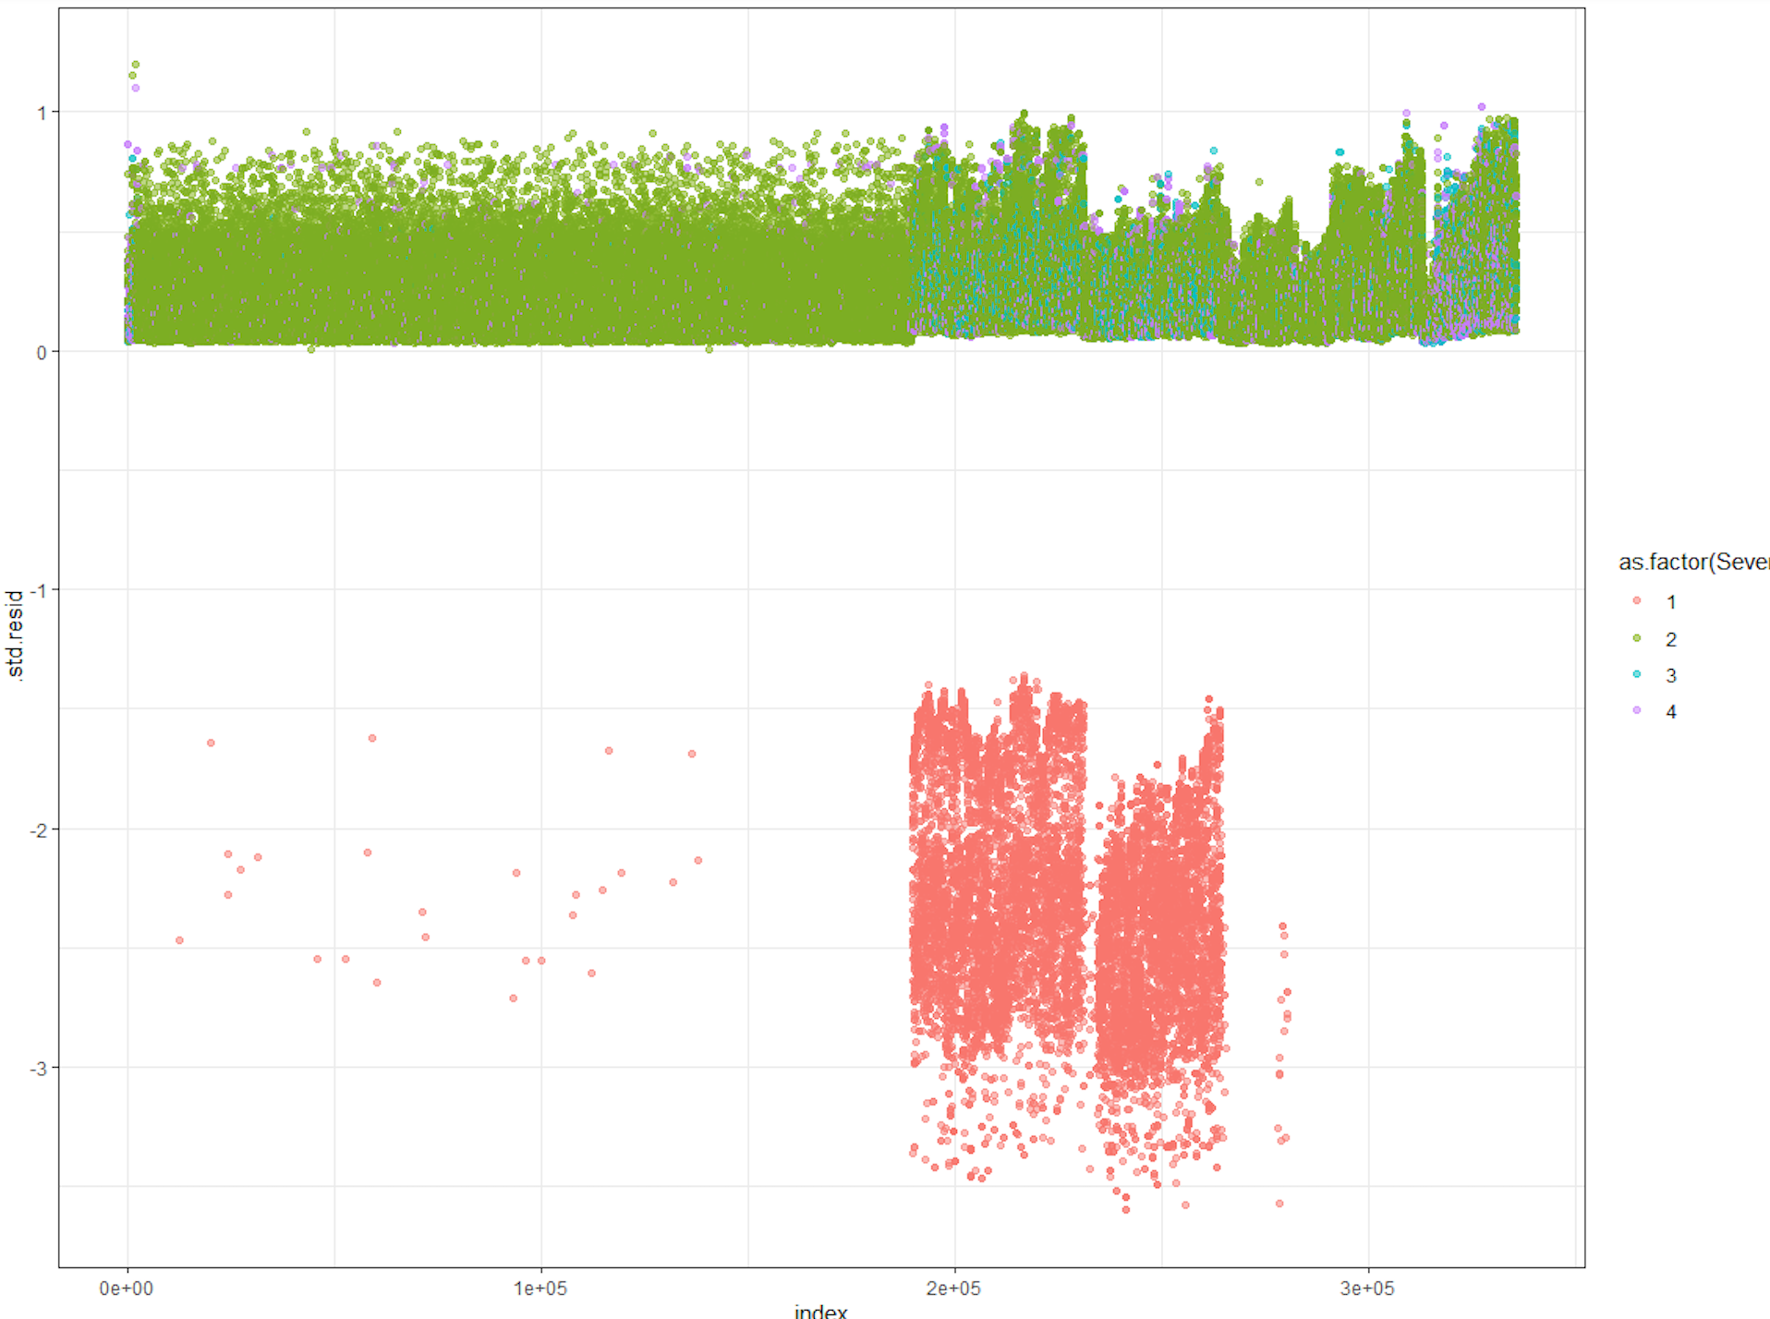
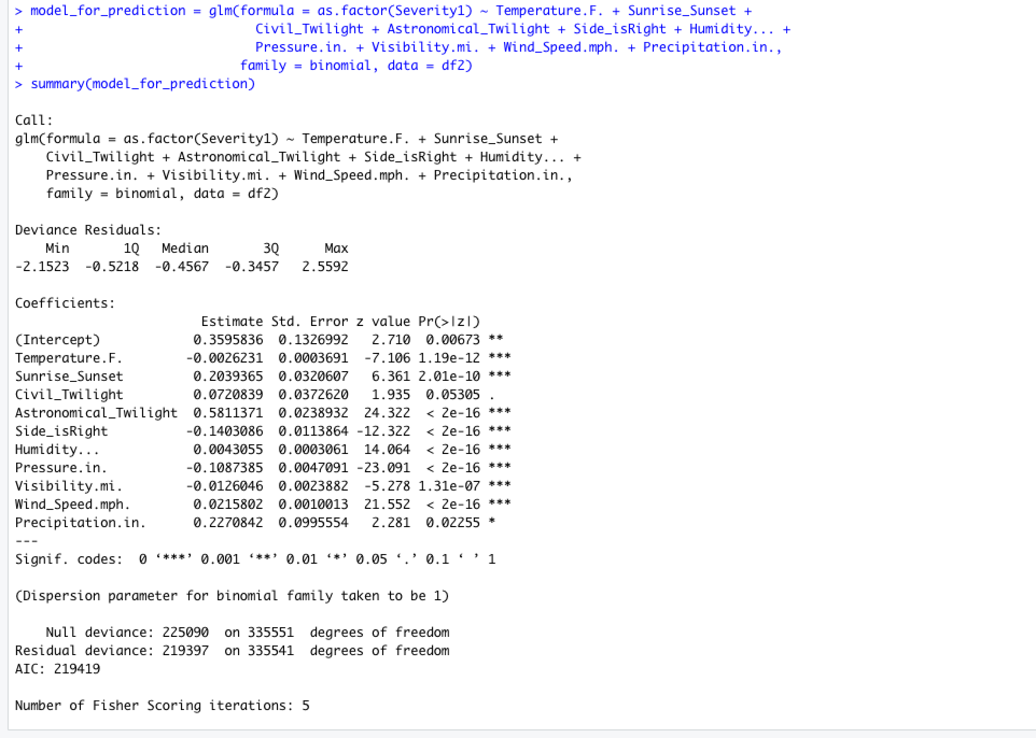
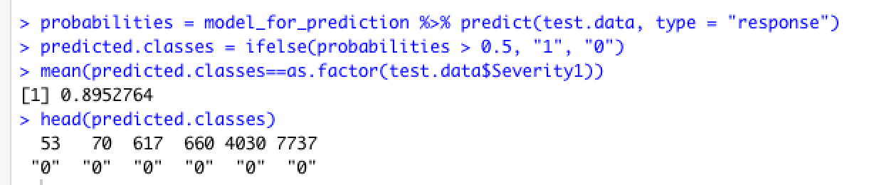

Slide 14
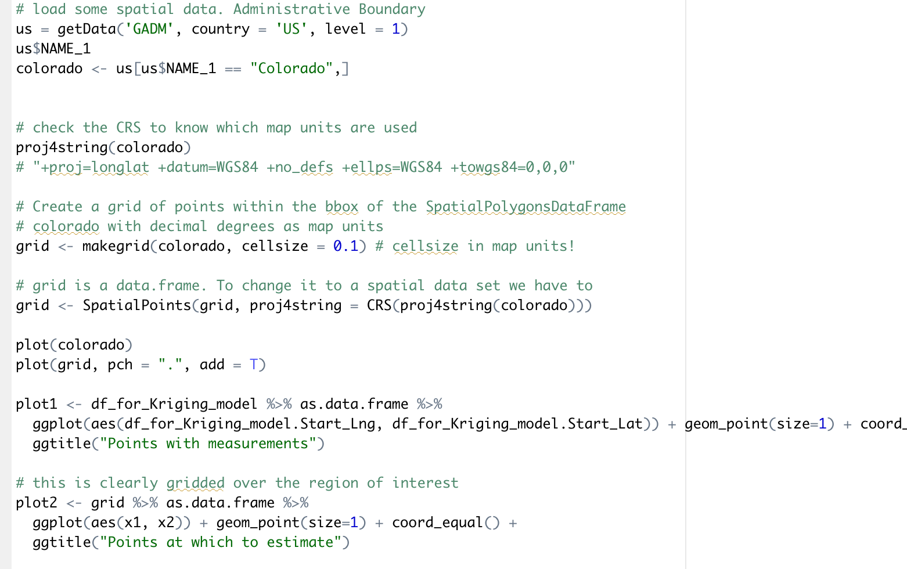

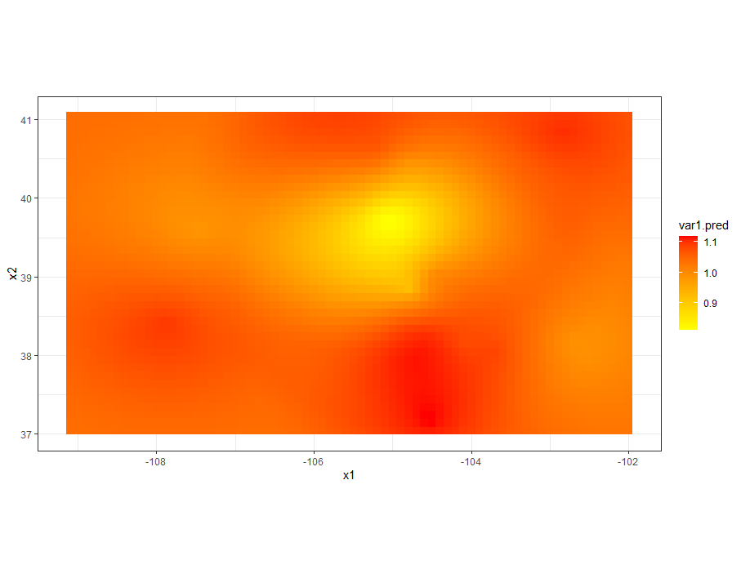
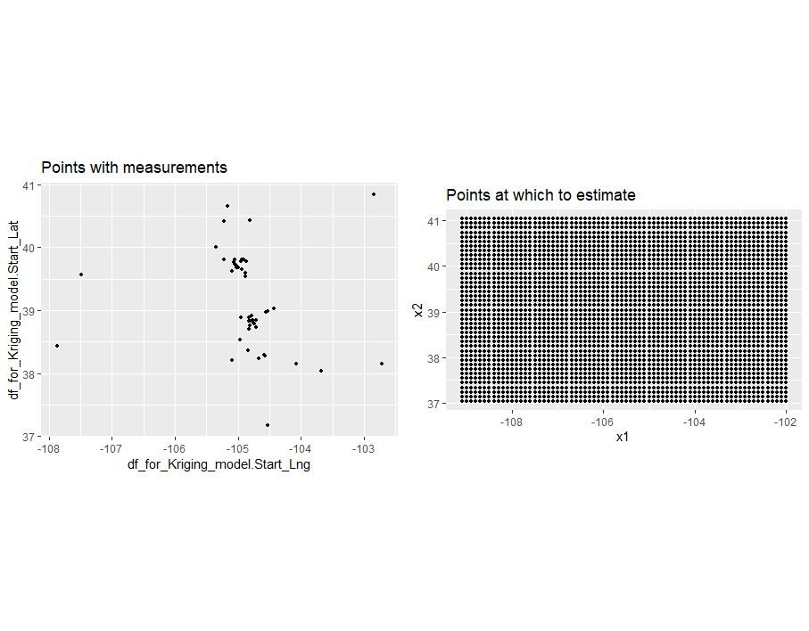
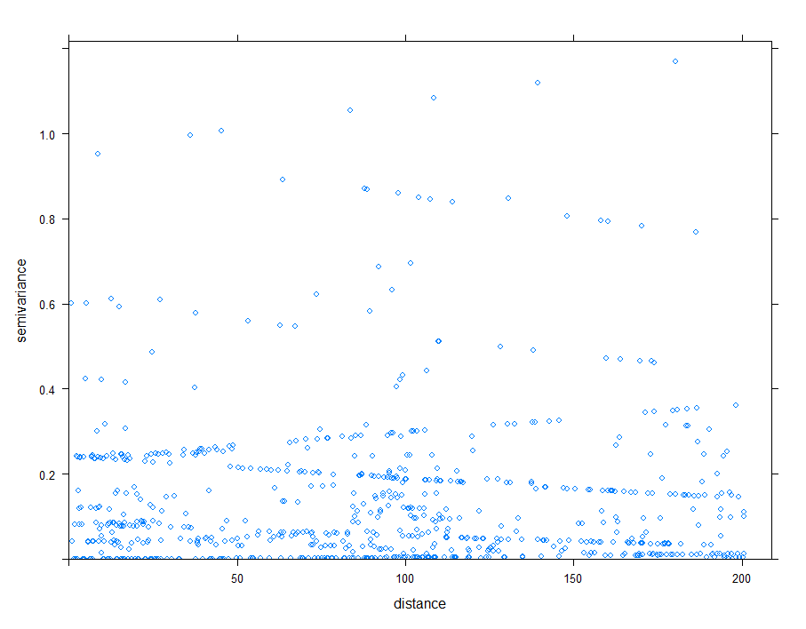
Kriging model

Slide 15
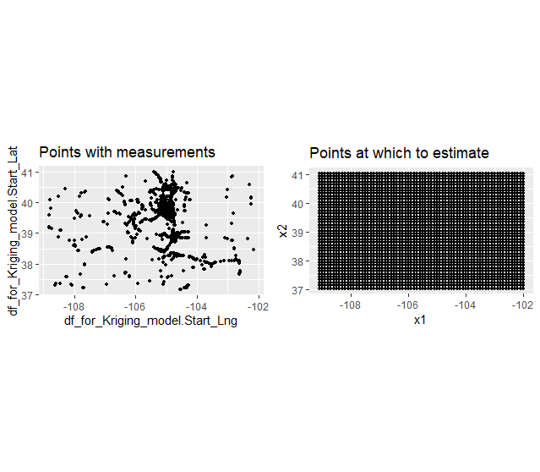
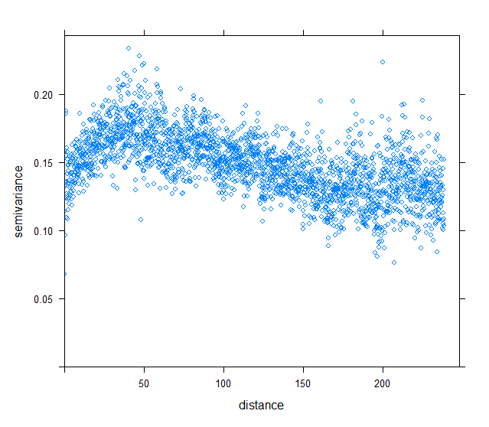
Notes:
Semivar vs distance: colorado-variance of distance..
Points wd measurements: colorado coordinates.. 3

Slide 16
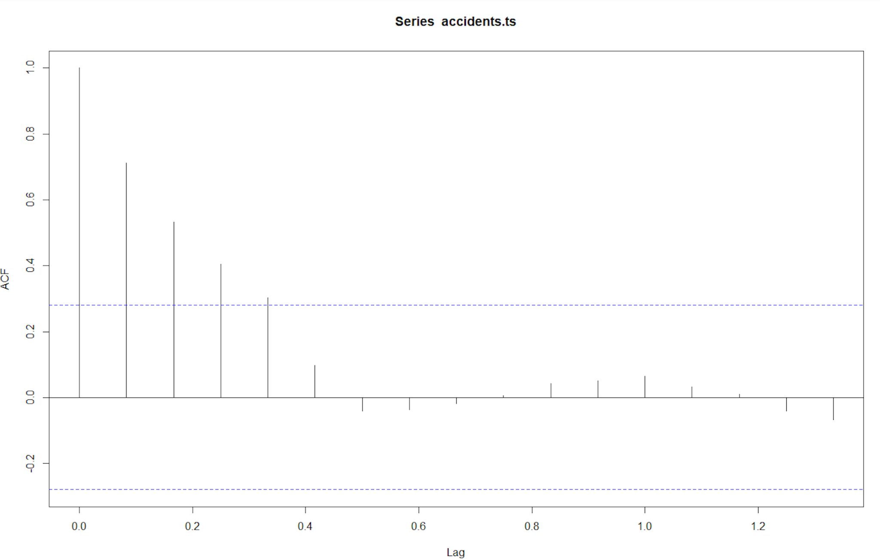
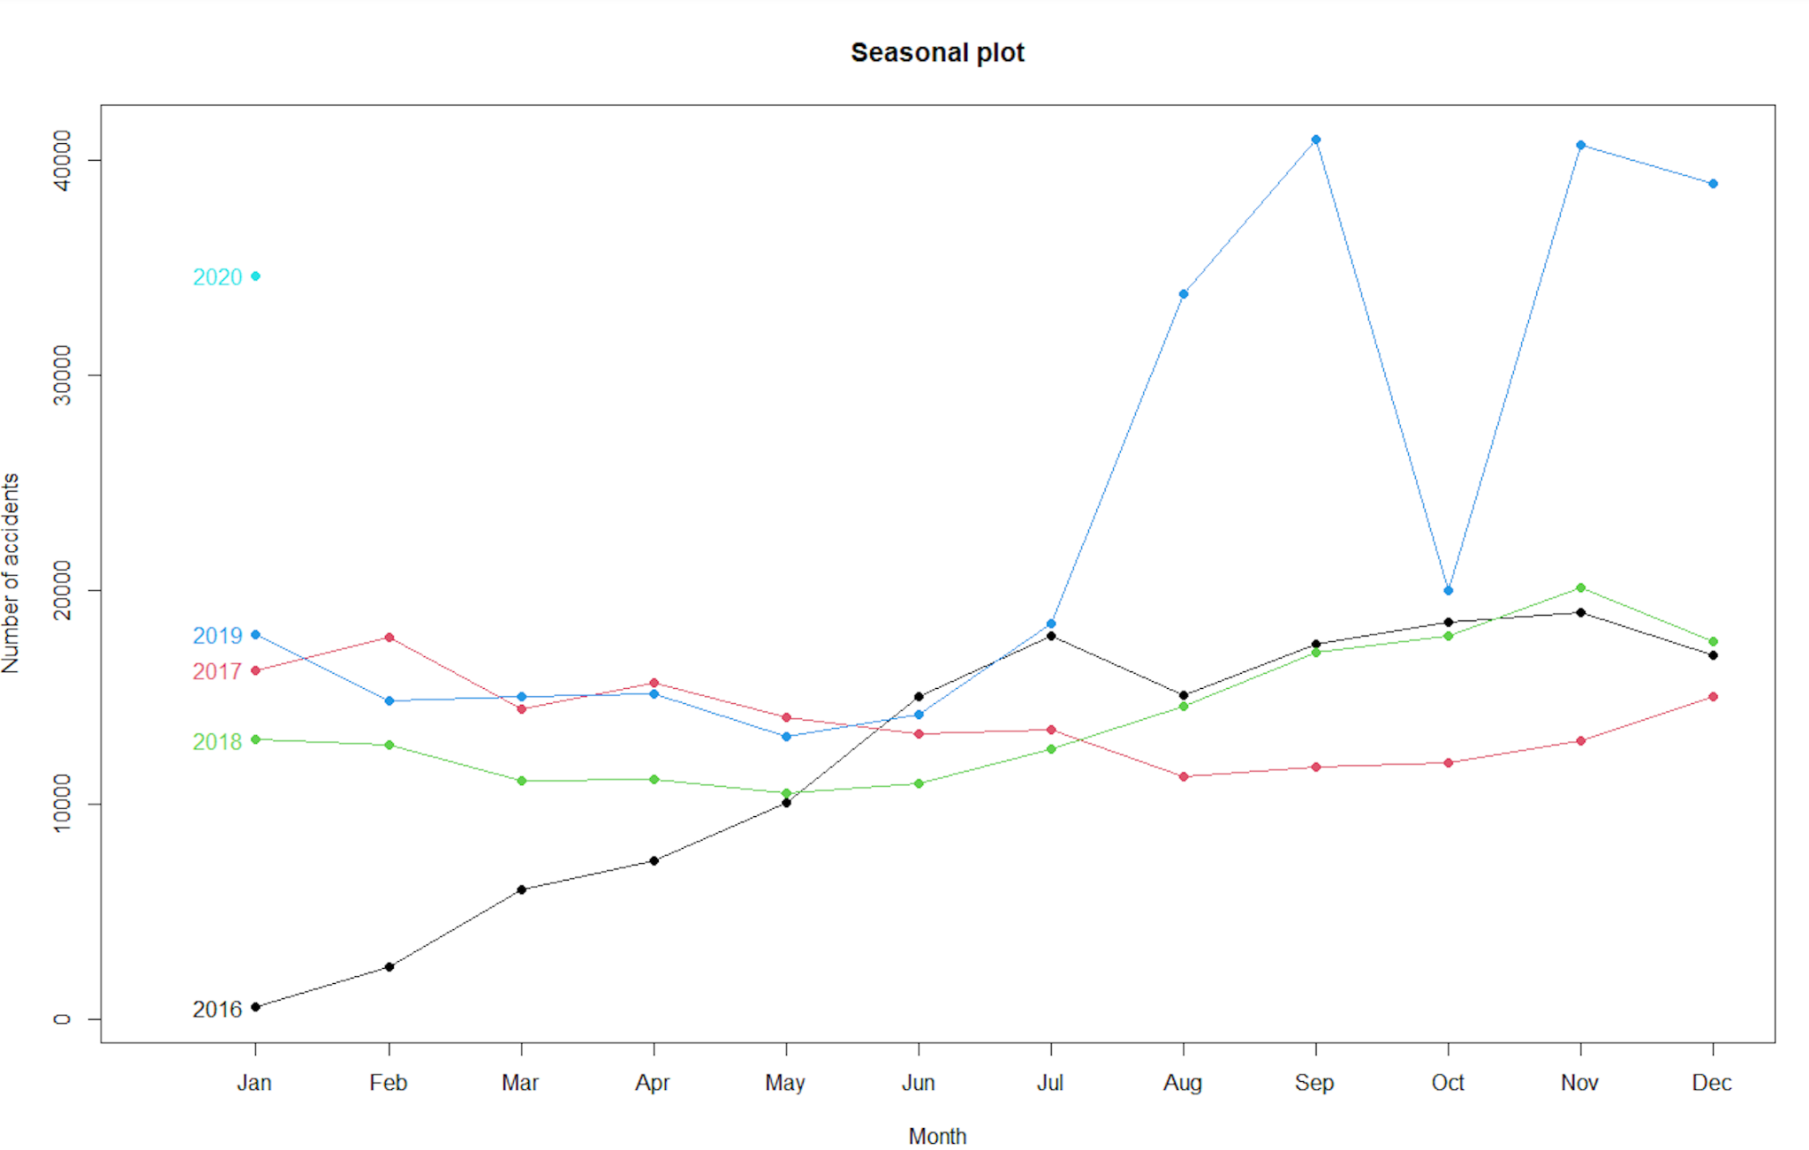
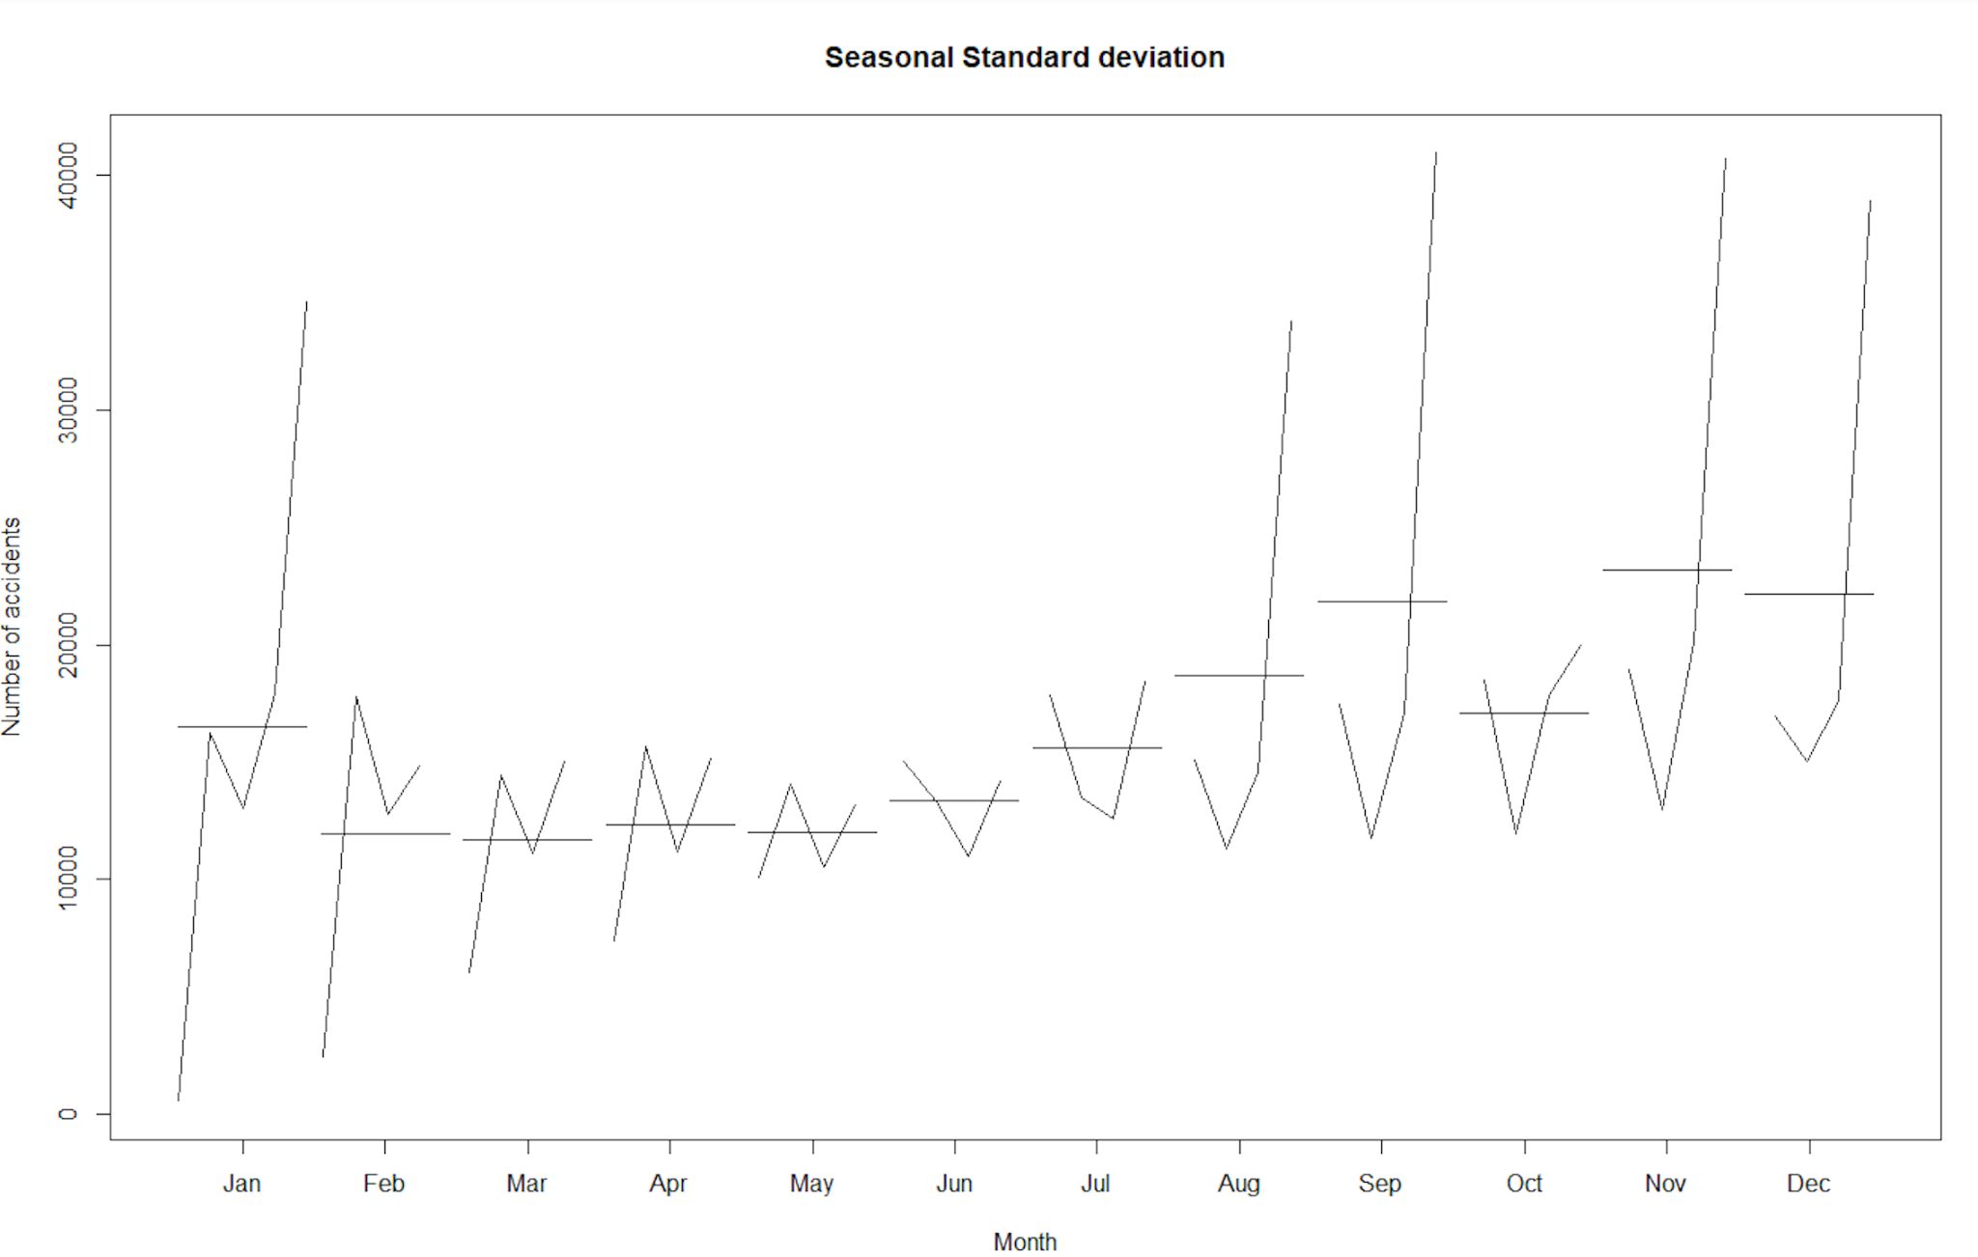
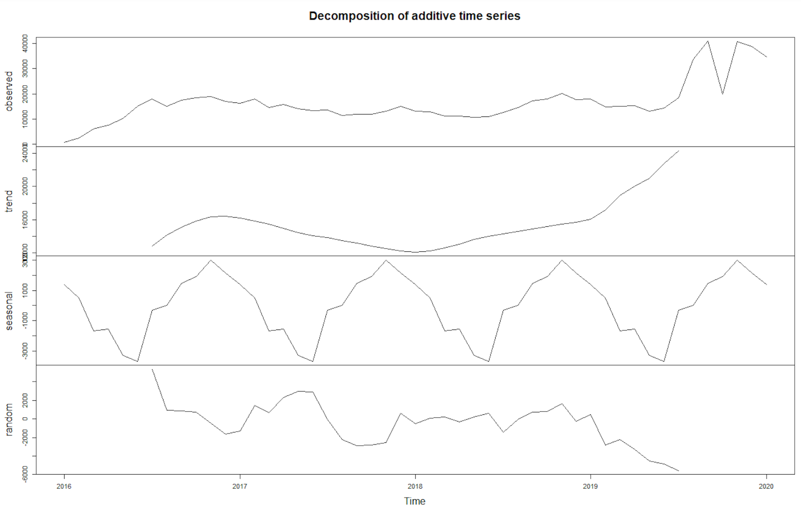
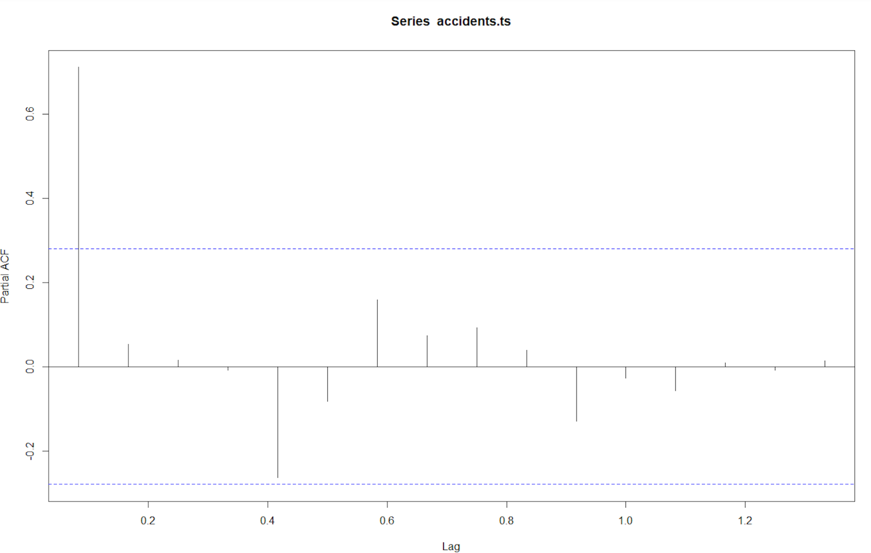
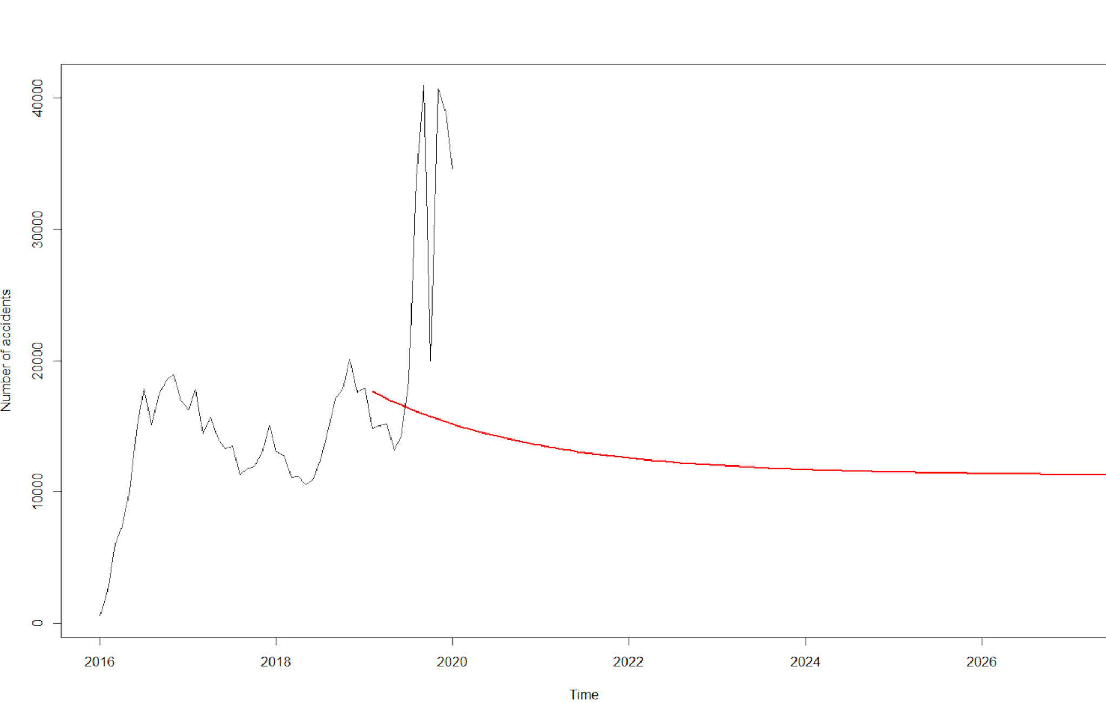
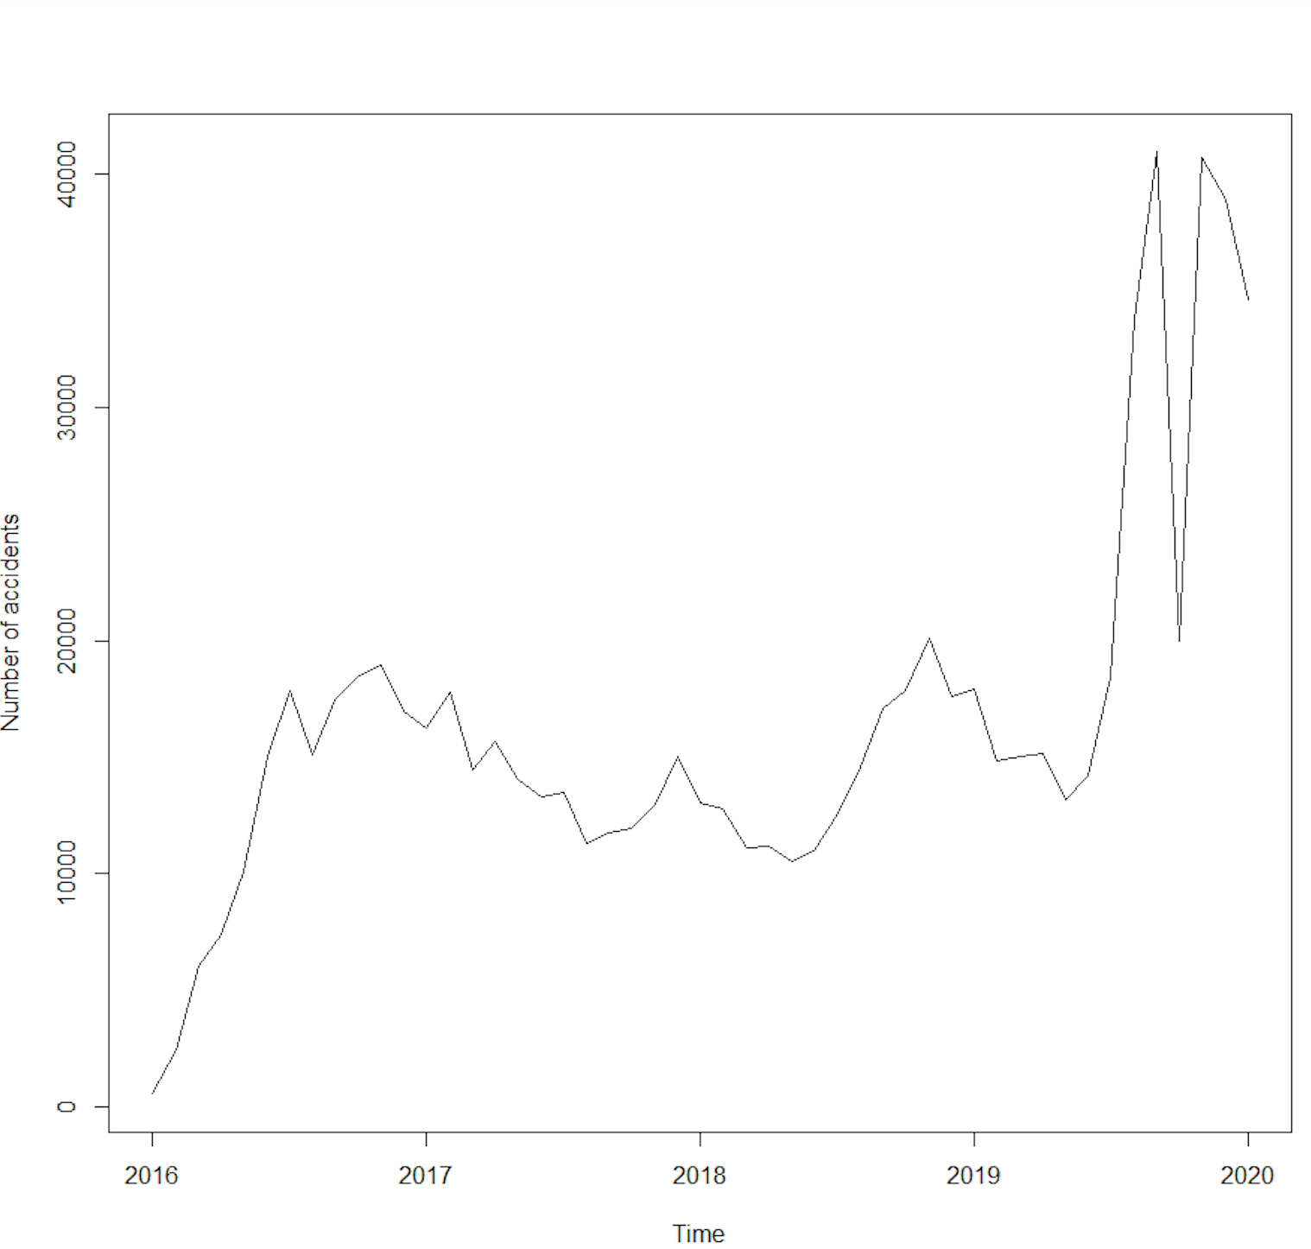
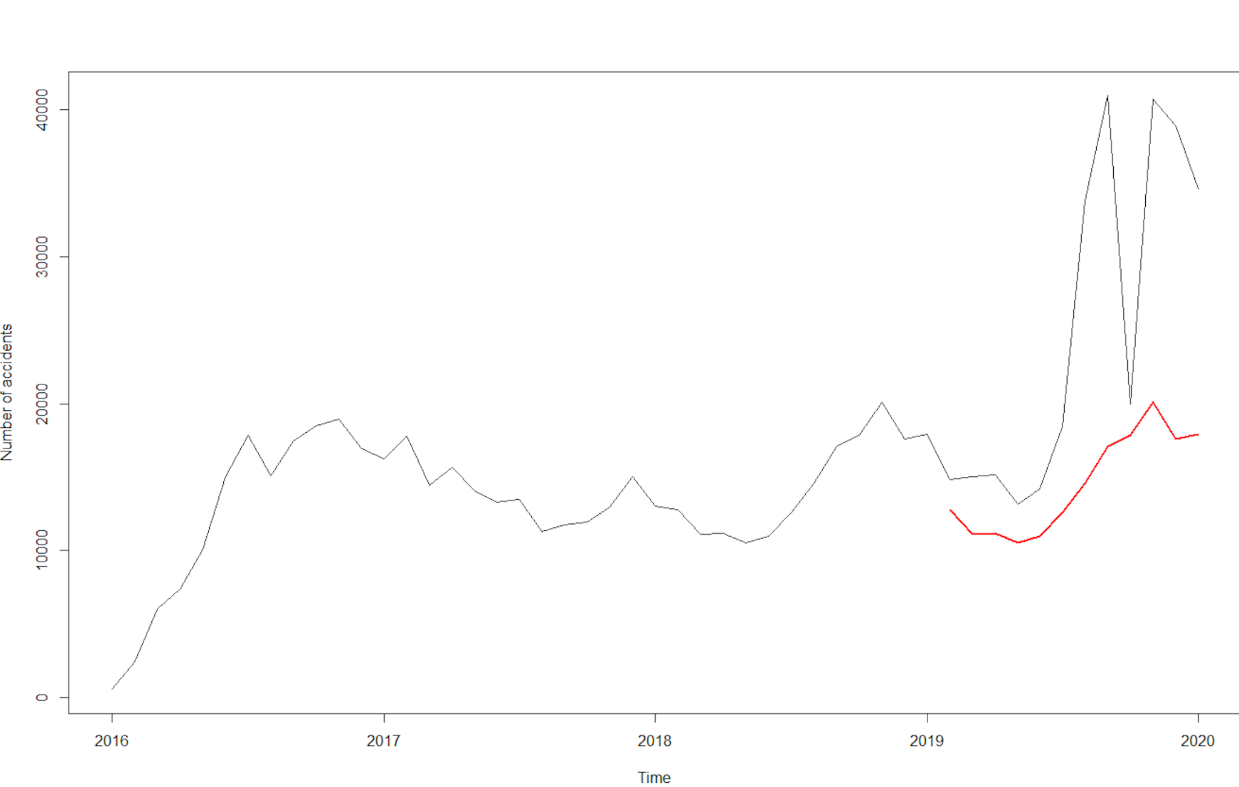
Time series forecasting

Slide 17




Findings
Number of accidents each hour(before cleaning):
Number of accidents each hour (after cleaning)are:

Slide 18


Findings
Highest number of accidents occurred in California

Slide 19


Findings
Severity of the accidents occurred is low.

Slide 20
Findings
Factors Affecting Accident Severity
Severity=1.583568-0.0328198*Temperature(F)-0.1880180*Civil_Twilight-0.2986898*Nautical_Twilight-0.9932627*Astronomical_twilight+0.0186887*Humidity+0.1526831*Pressure+0.0062393*wind_speed(mph)-0.4012353*Precipitation(in)

Slide 21


Findings
Most number of accidents occurred in Miami-Dade County,Florida(33186)

Slide 22


Findings
Most number of accidents occurred in the street Highway 101(California, Oregon,Washington)

Slide 23
Recommendations
The response teams and hospitals must be given special provisions in the hours in which most accidents are occurred.
Warning signs about speed limits are to be put in the accident prone streets
The state with highest accidents must be provided with better resources and budget plans to avoid accidents and rescue the victims.
Warnings are to be put depending on the weather conditions which cause accidents.
A mandate of vehicles to have first aid kit should be passed.
Online surveillance for prompt response from emergency services should be implemented.
To have enough response teams to rescue in accident prone locations

Slide 24


